Slide 1
Webinar
LS Central for pharmacy
May 5th 2020
Henrik O. Thordarson Pharmacist, Senior Consultant
Stefán Georgsson, Product Director Pharmacy

Slide 2
Pharmacy software for pharmacies of all sizes
It manages various types of prescriptions, handles drugs effectively and keeps track of the pharmaceutical stock across all stores
It covers the daily routines in a pharmacy, from back office to POS
It supports effective data structure for medications and efficient handling of pharmaceuticals
Users can enter and search products in the system through different dimensions from substance, ATC group, strength and classification to warning text, product description, quantity in pack, daily dose and more
Based on LS Central and Business Central
LS Central for pharmacy - Overview

Slide 3
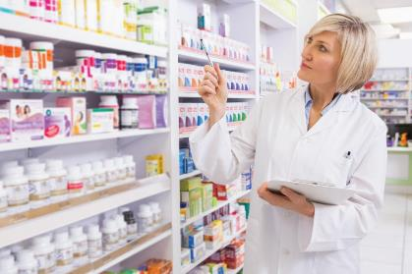
All standard Prescription processes
Prescription handling
Paper, Electronic, Emergency, etc
Generic substitution
Integration framework for e-Prescriptions and Insurance
Pharmaceutical control
Pick control & FMD Control
Animal Prescription
Order requests when item is not on stock and Subscriptions
Pharmacy specific user permissions
Customer identification
Pharmacy customer database or link to national registry
Handling of Power of Attorney and Care units
Master data import and management
Master data for Prescription handling
Pharmaceutical Items
Item Groups including ATC and Substance Groups
Health Personnel
Key Functionality Areas

Slide 4
Country
Integration
LS Central for pharmacy
Modular design of LS Central and LS Central for pharmacy
LS Central
MS Dynamics 365 Business Central
Overview - Lego methodology

Slide 5
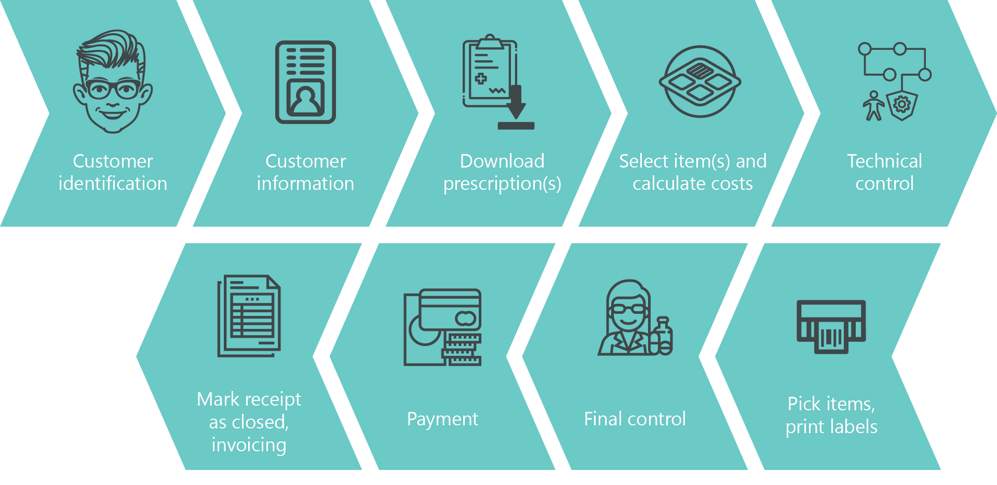
ePrescription flow in LS Central for pharmacy

Slide 6
Demo – Classic UI

Slide 7
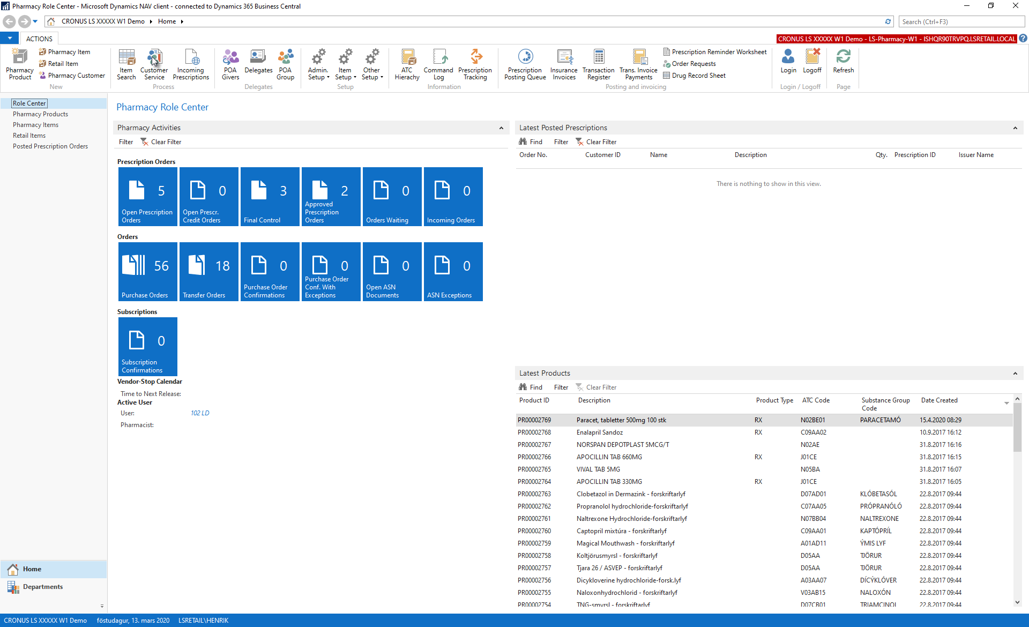

Slide 8
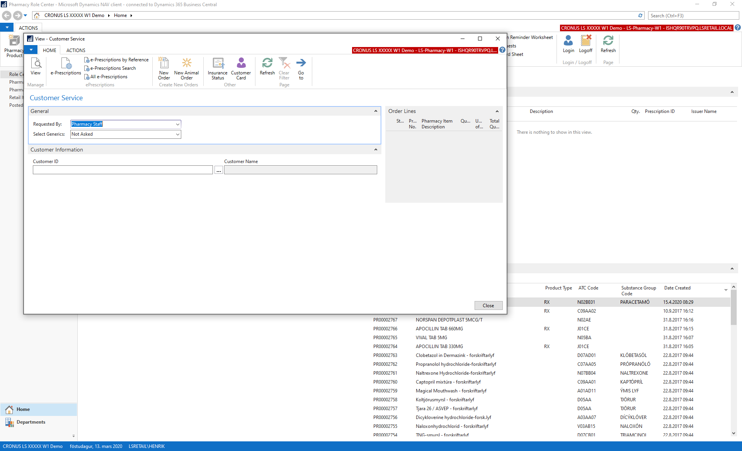

Slide 9
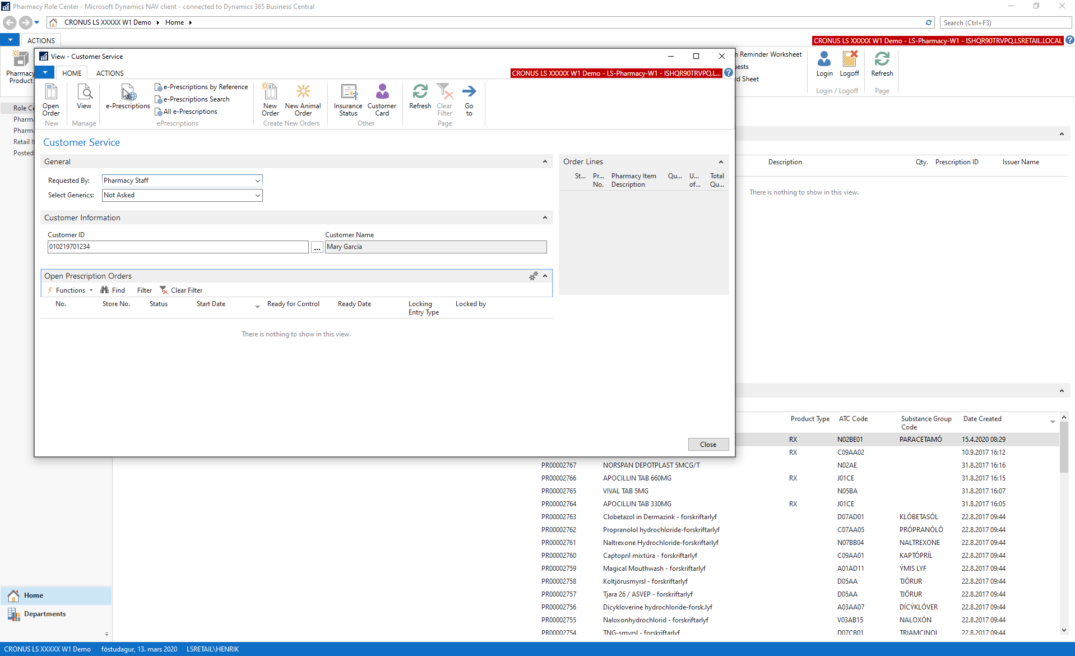

Slide 10
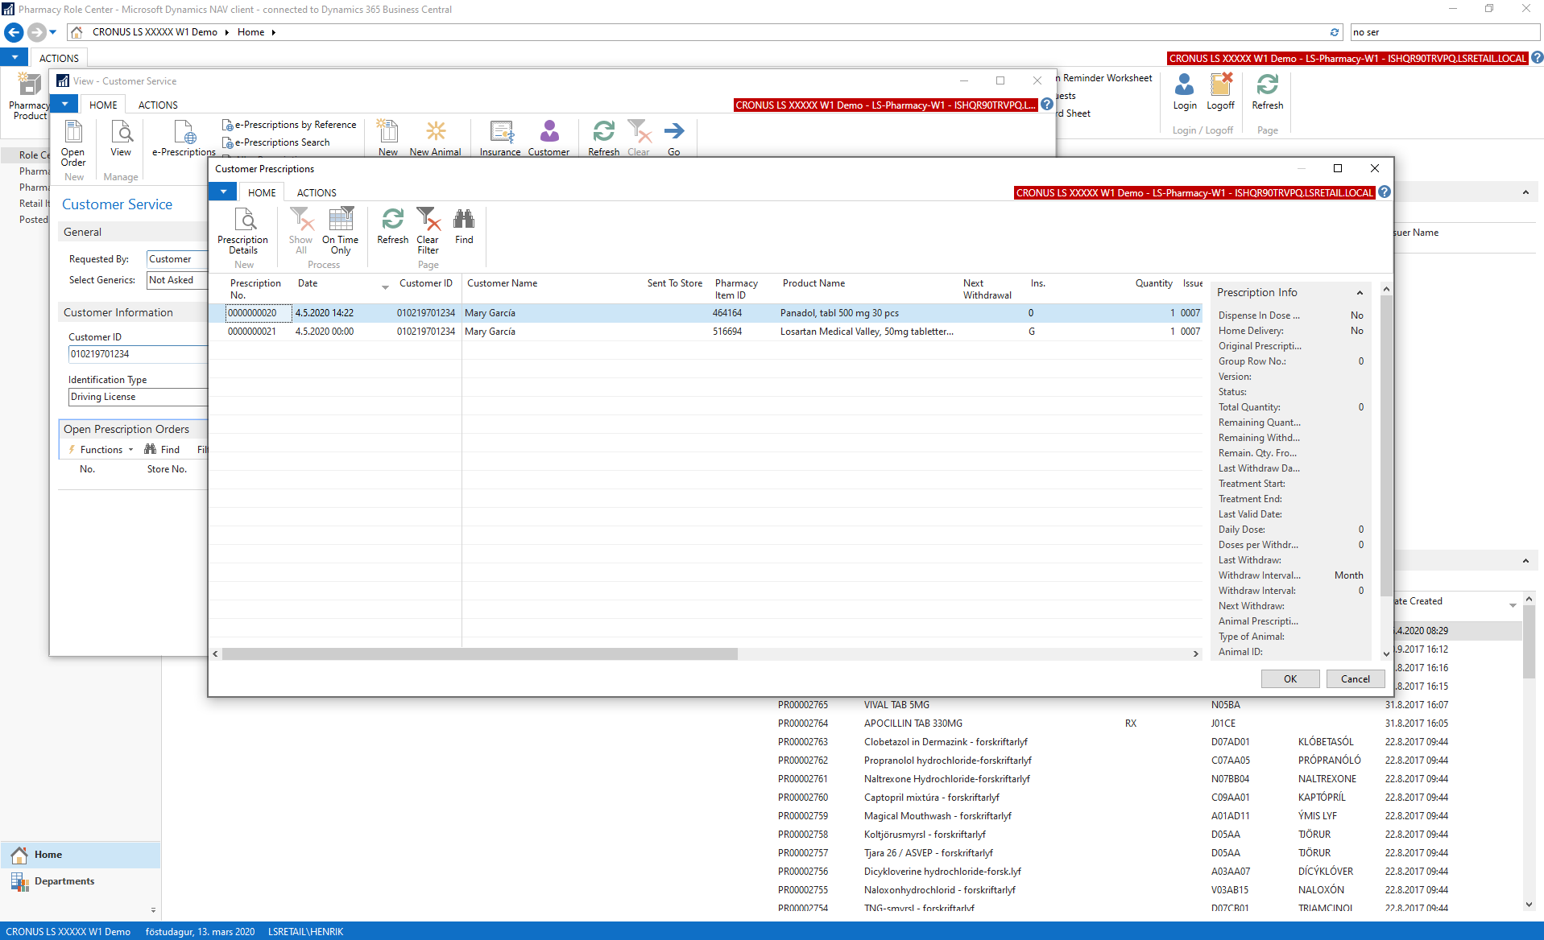

Slide 11
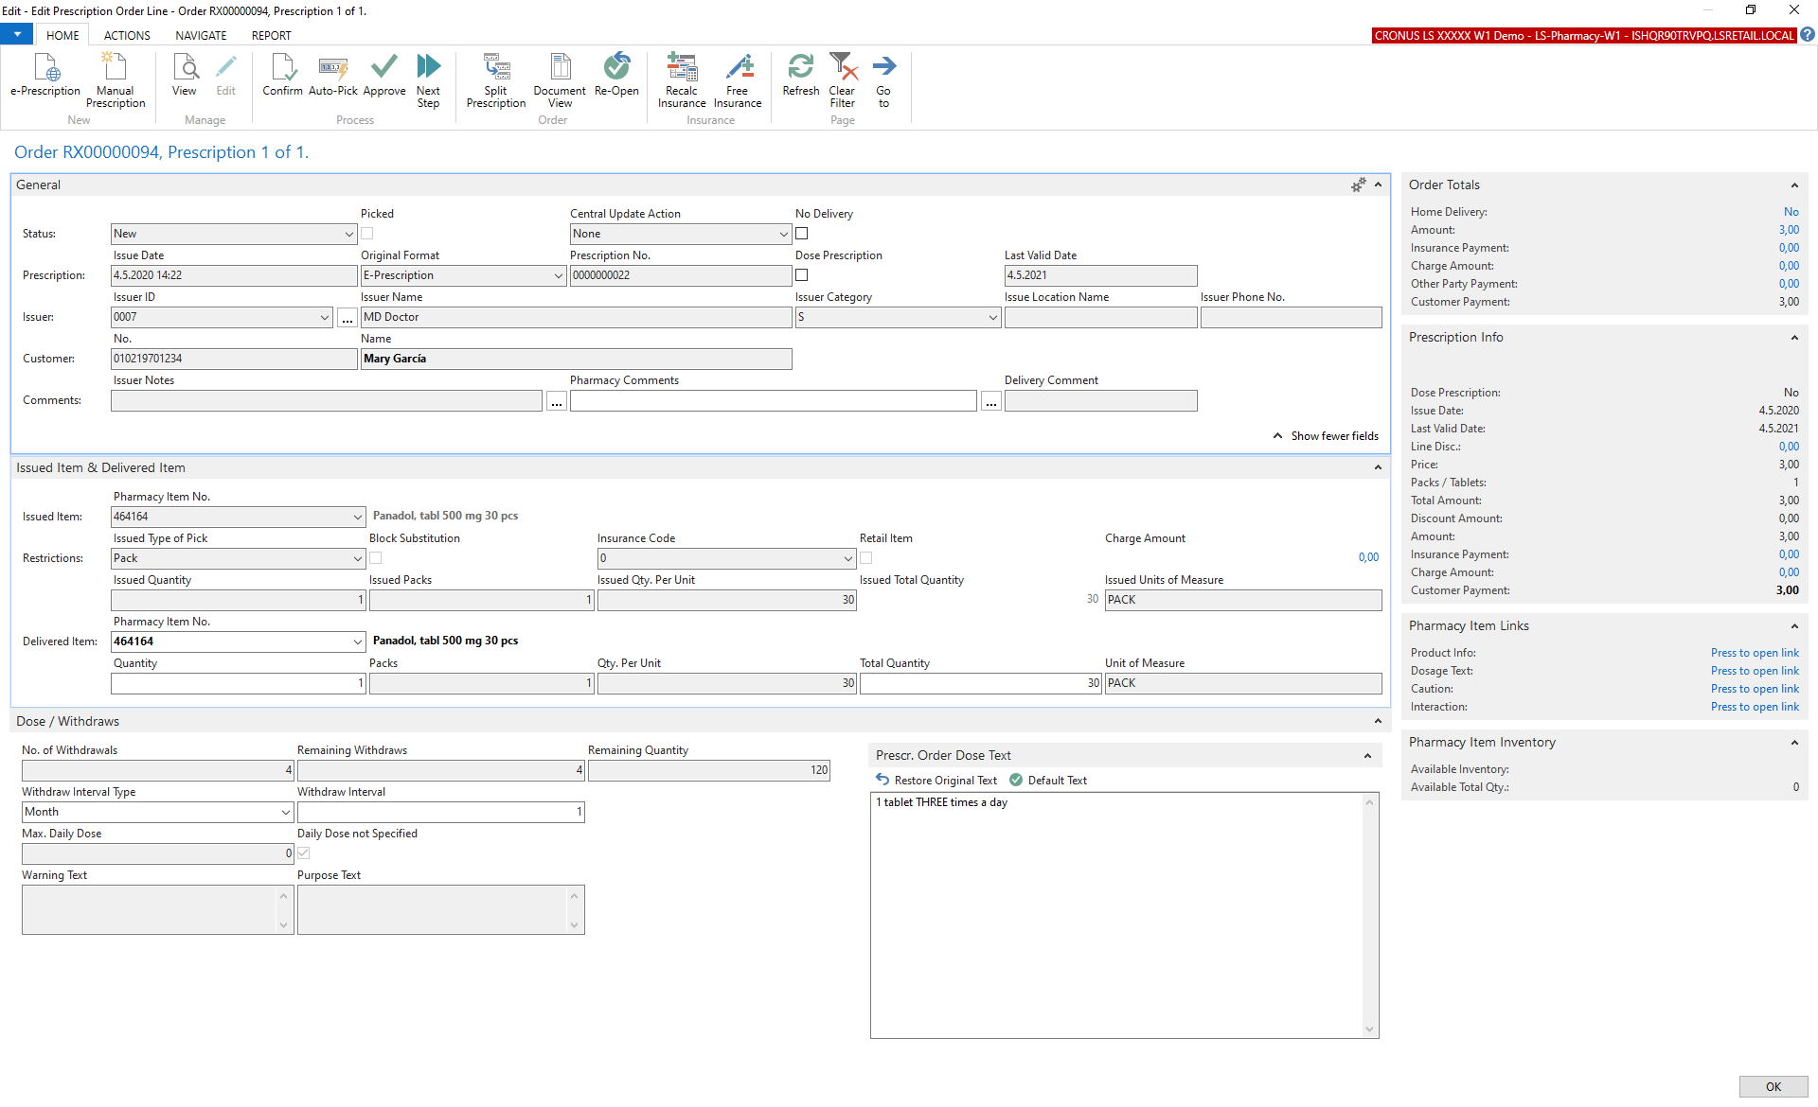

Slide 12
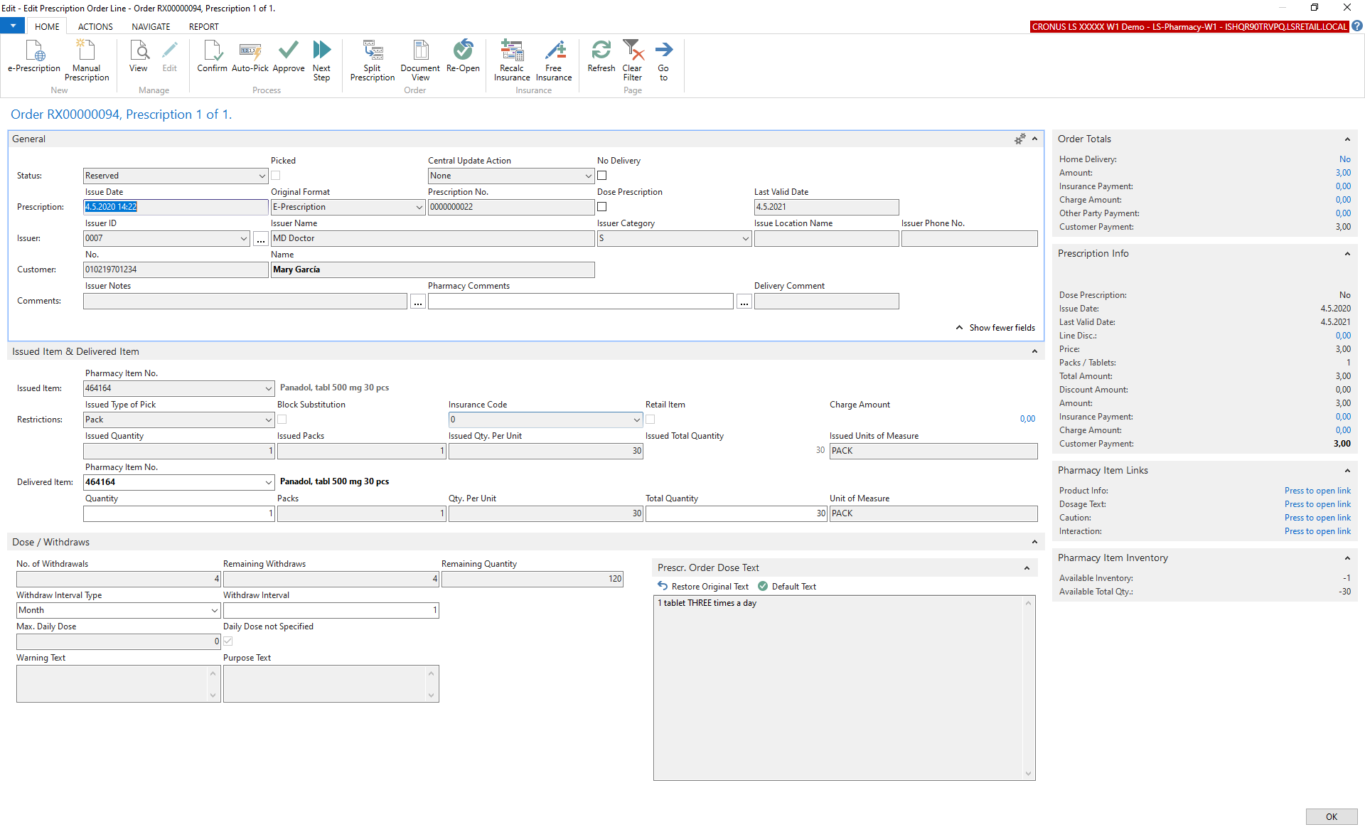

Slide 13
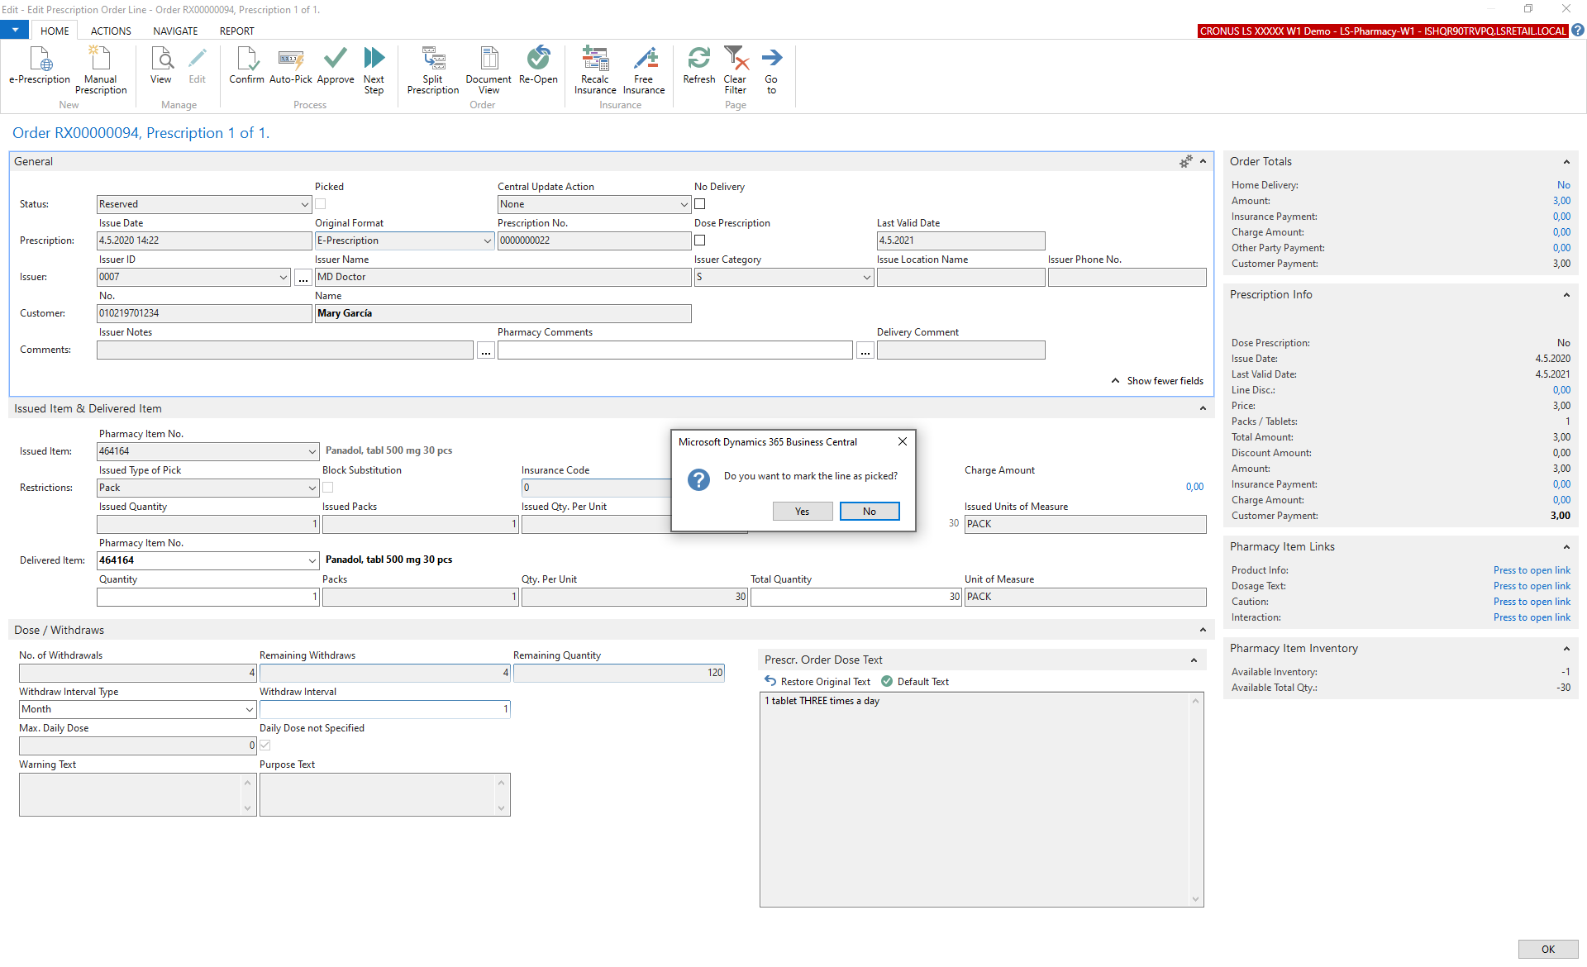

Slide 14
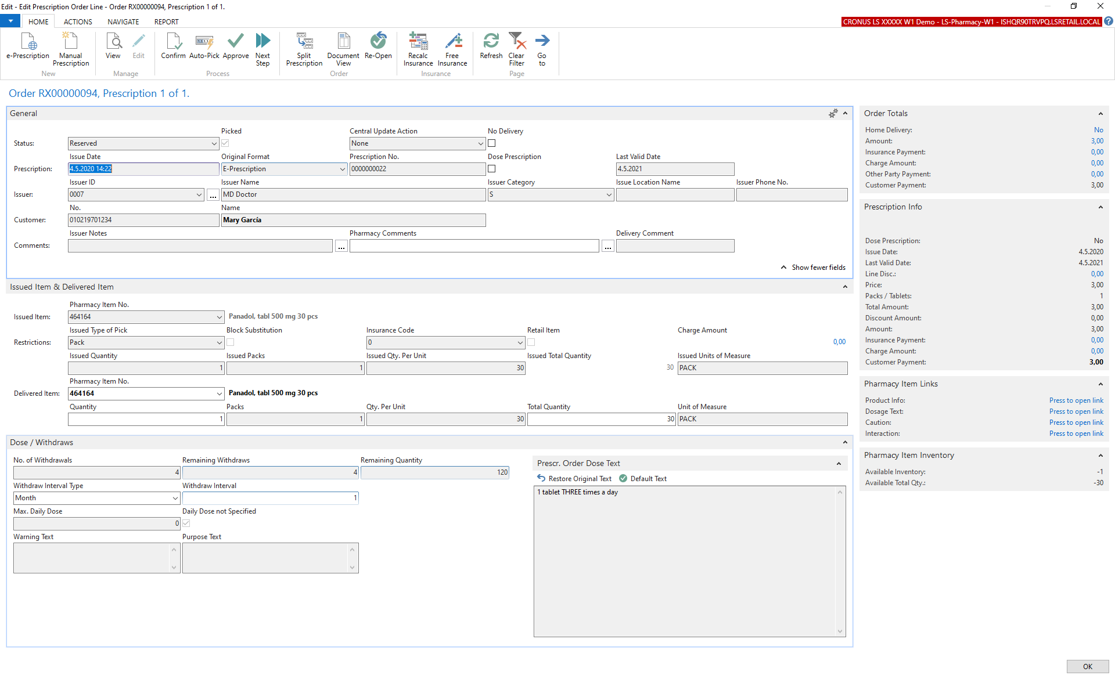

Slide 15
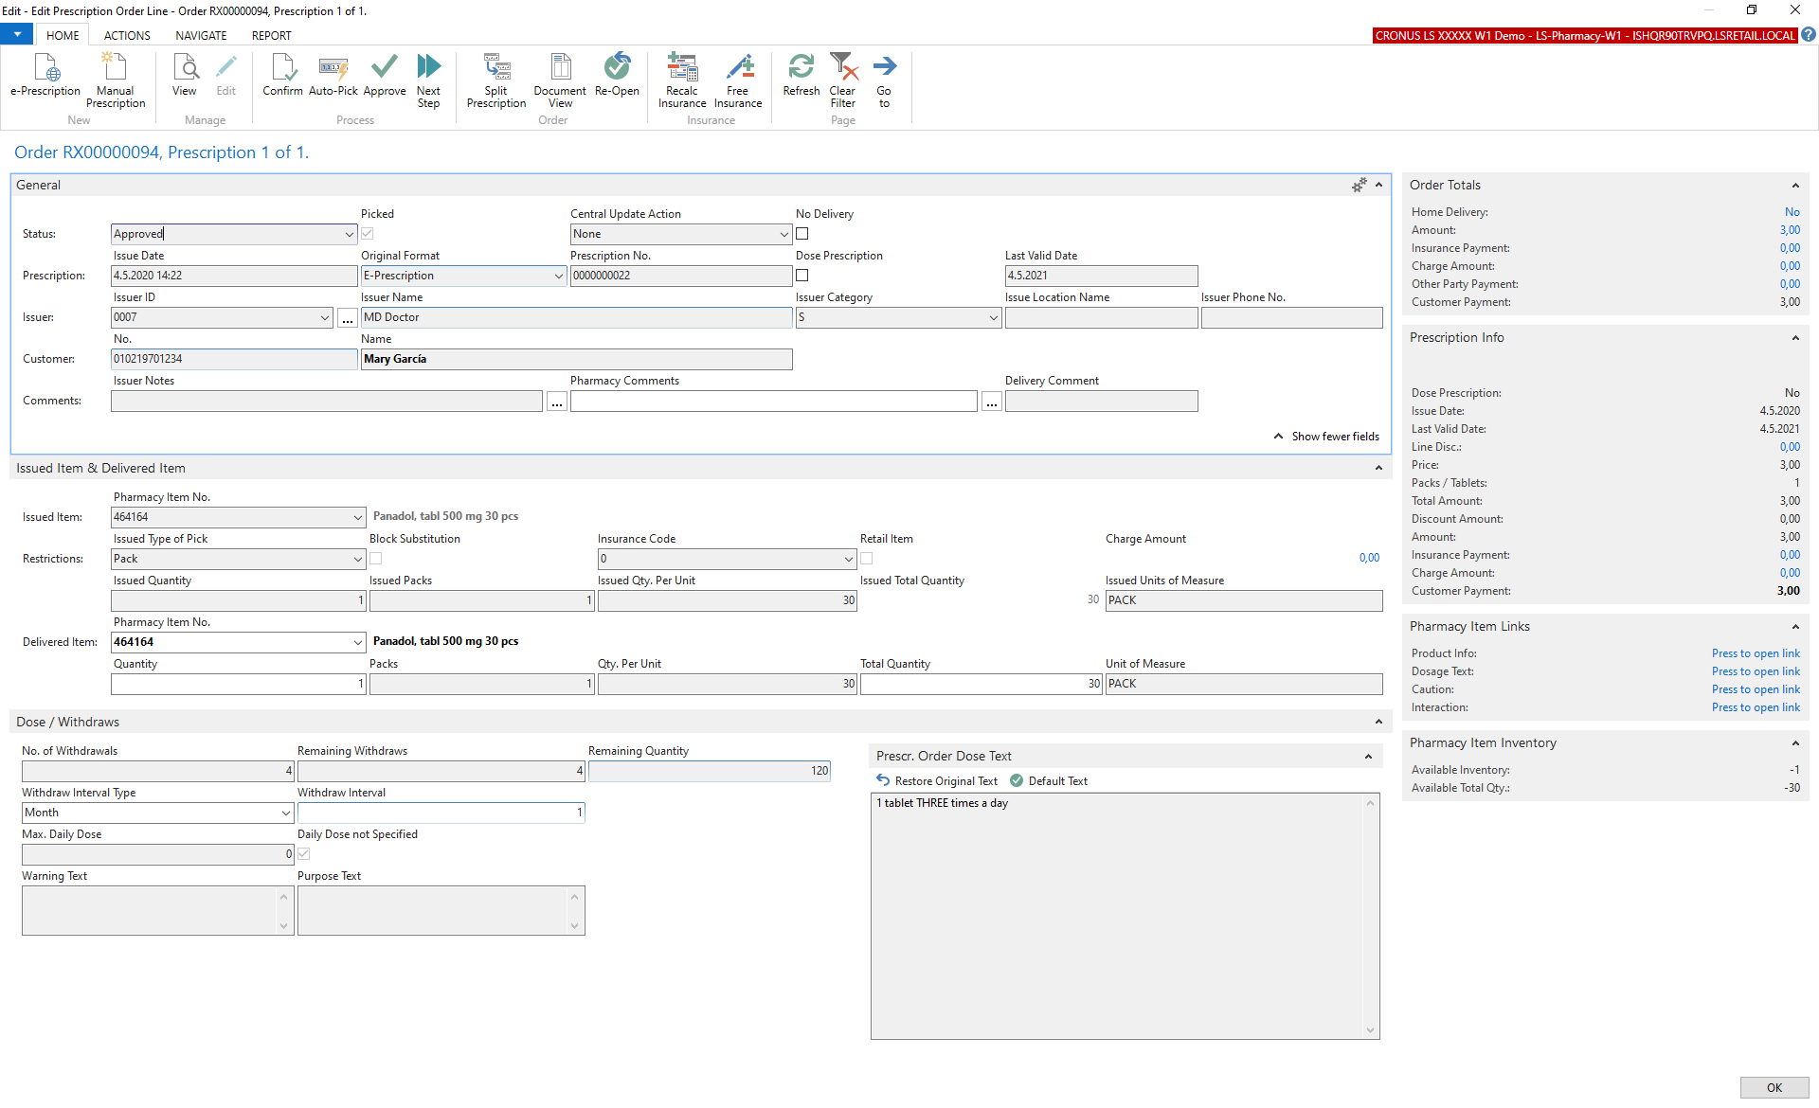

Slide 16
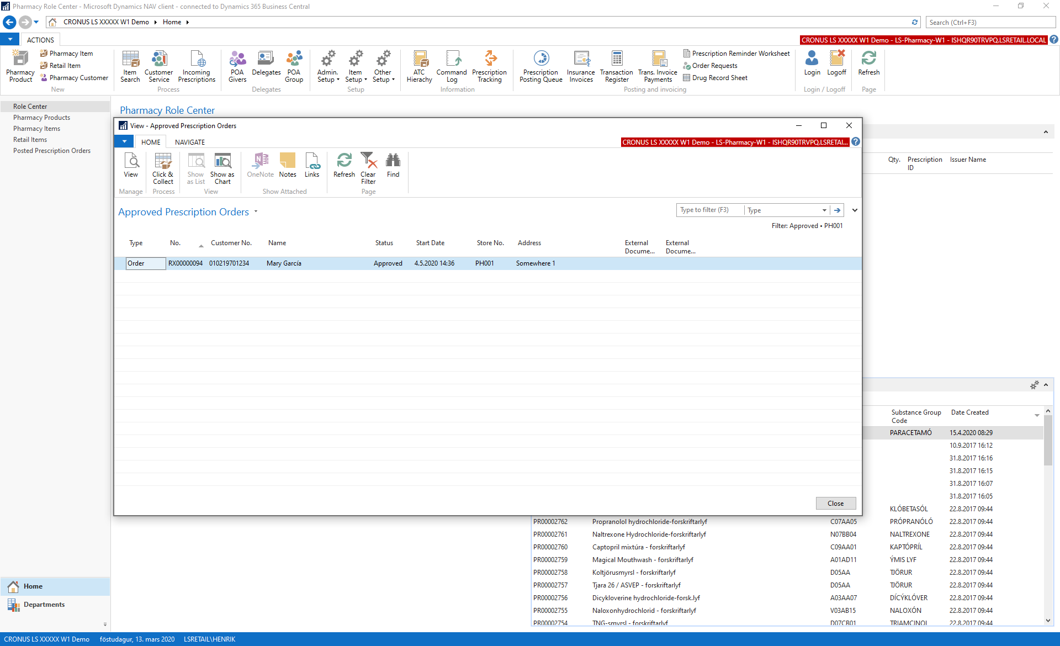

Slide 17
Demo – POS UI

Slide 18
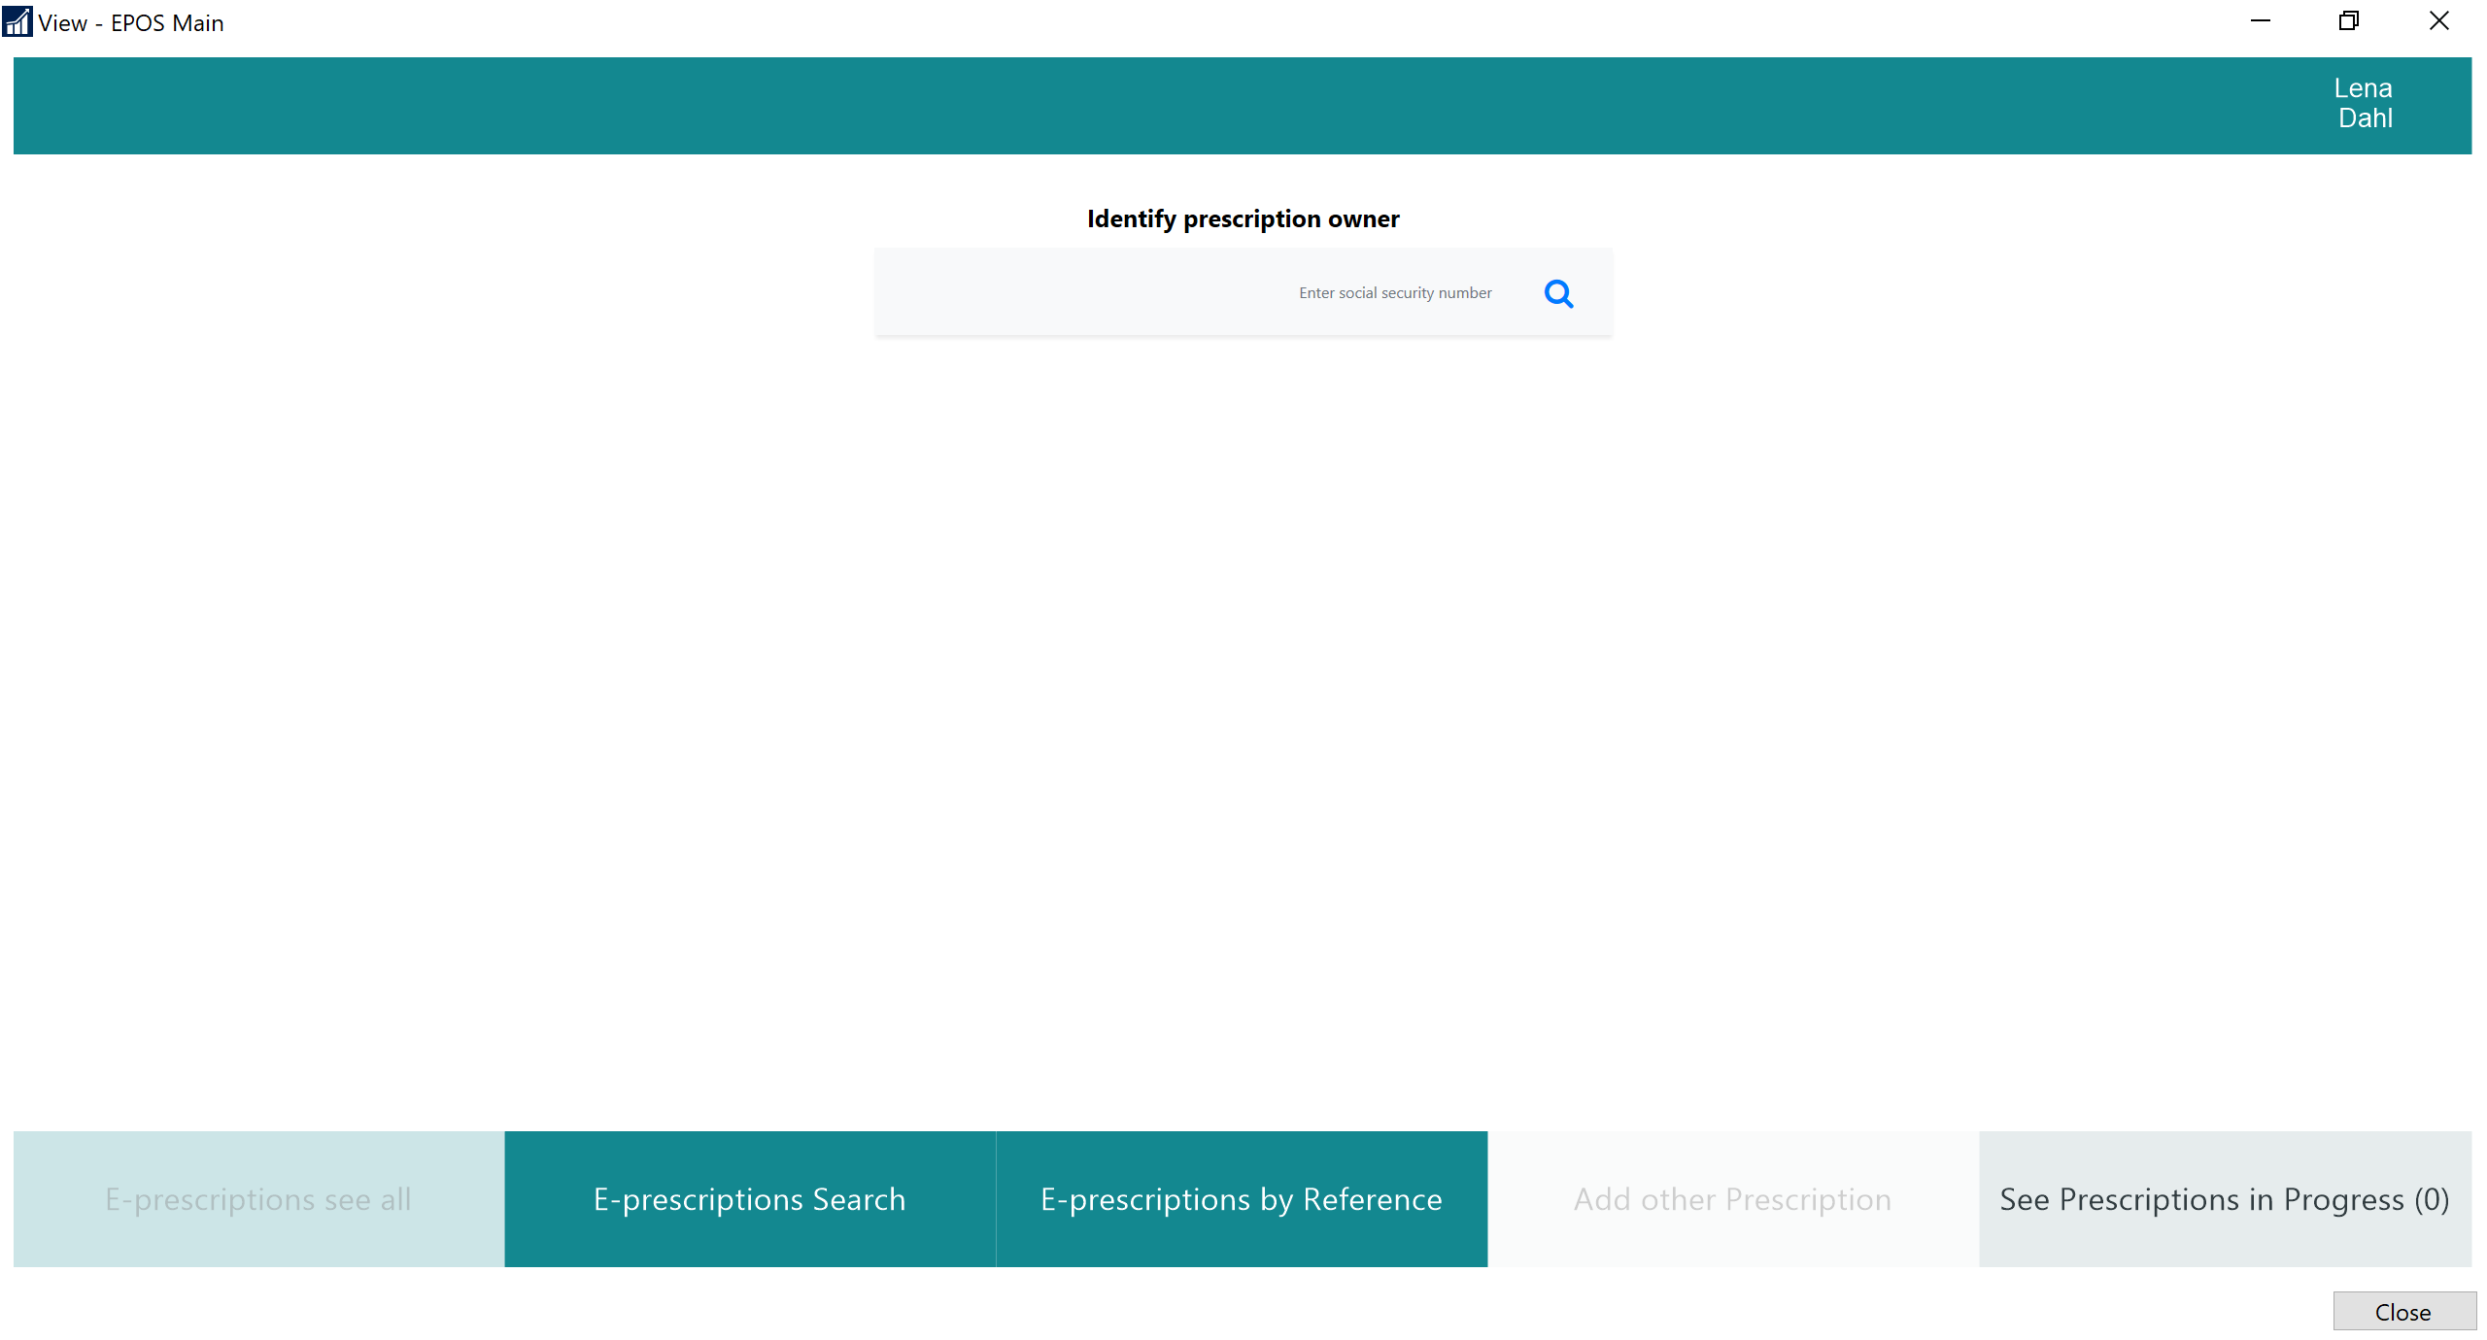

Slide 19
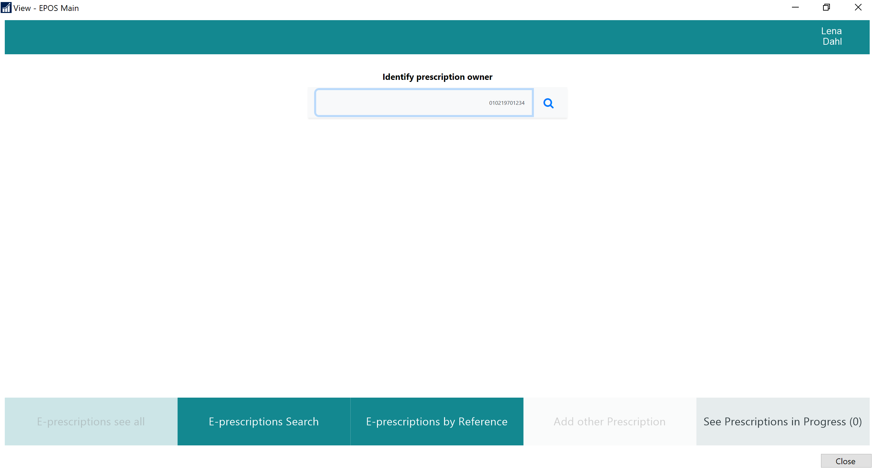

Slide 20
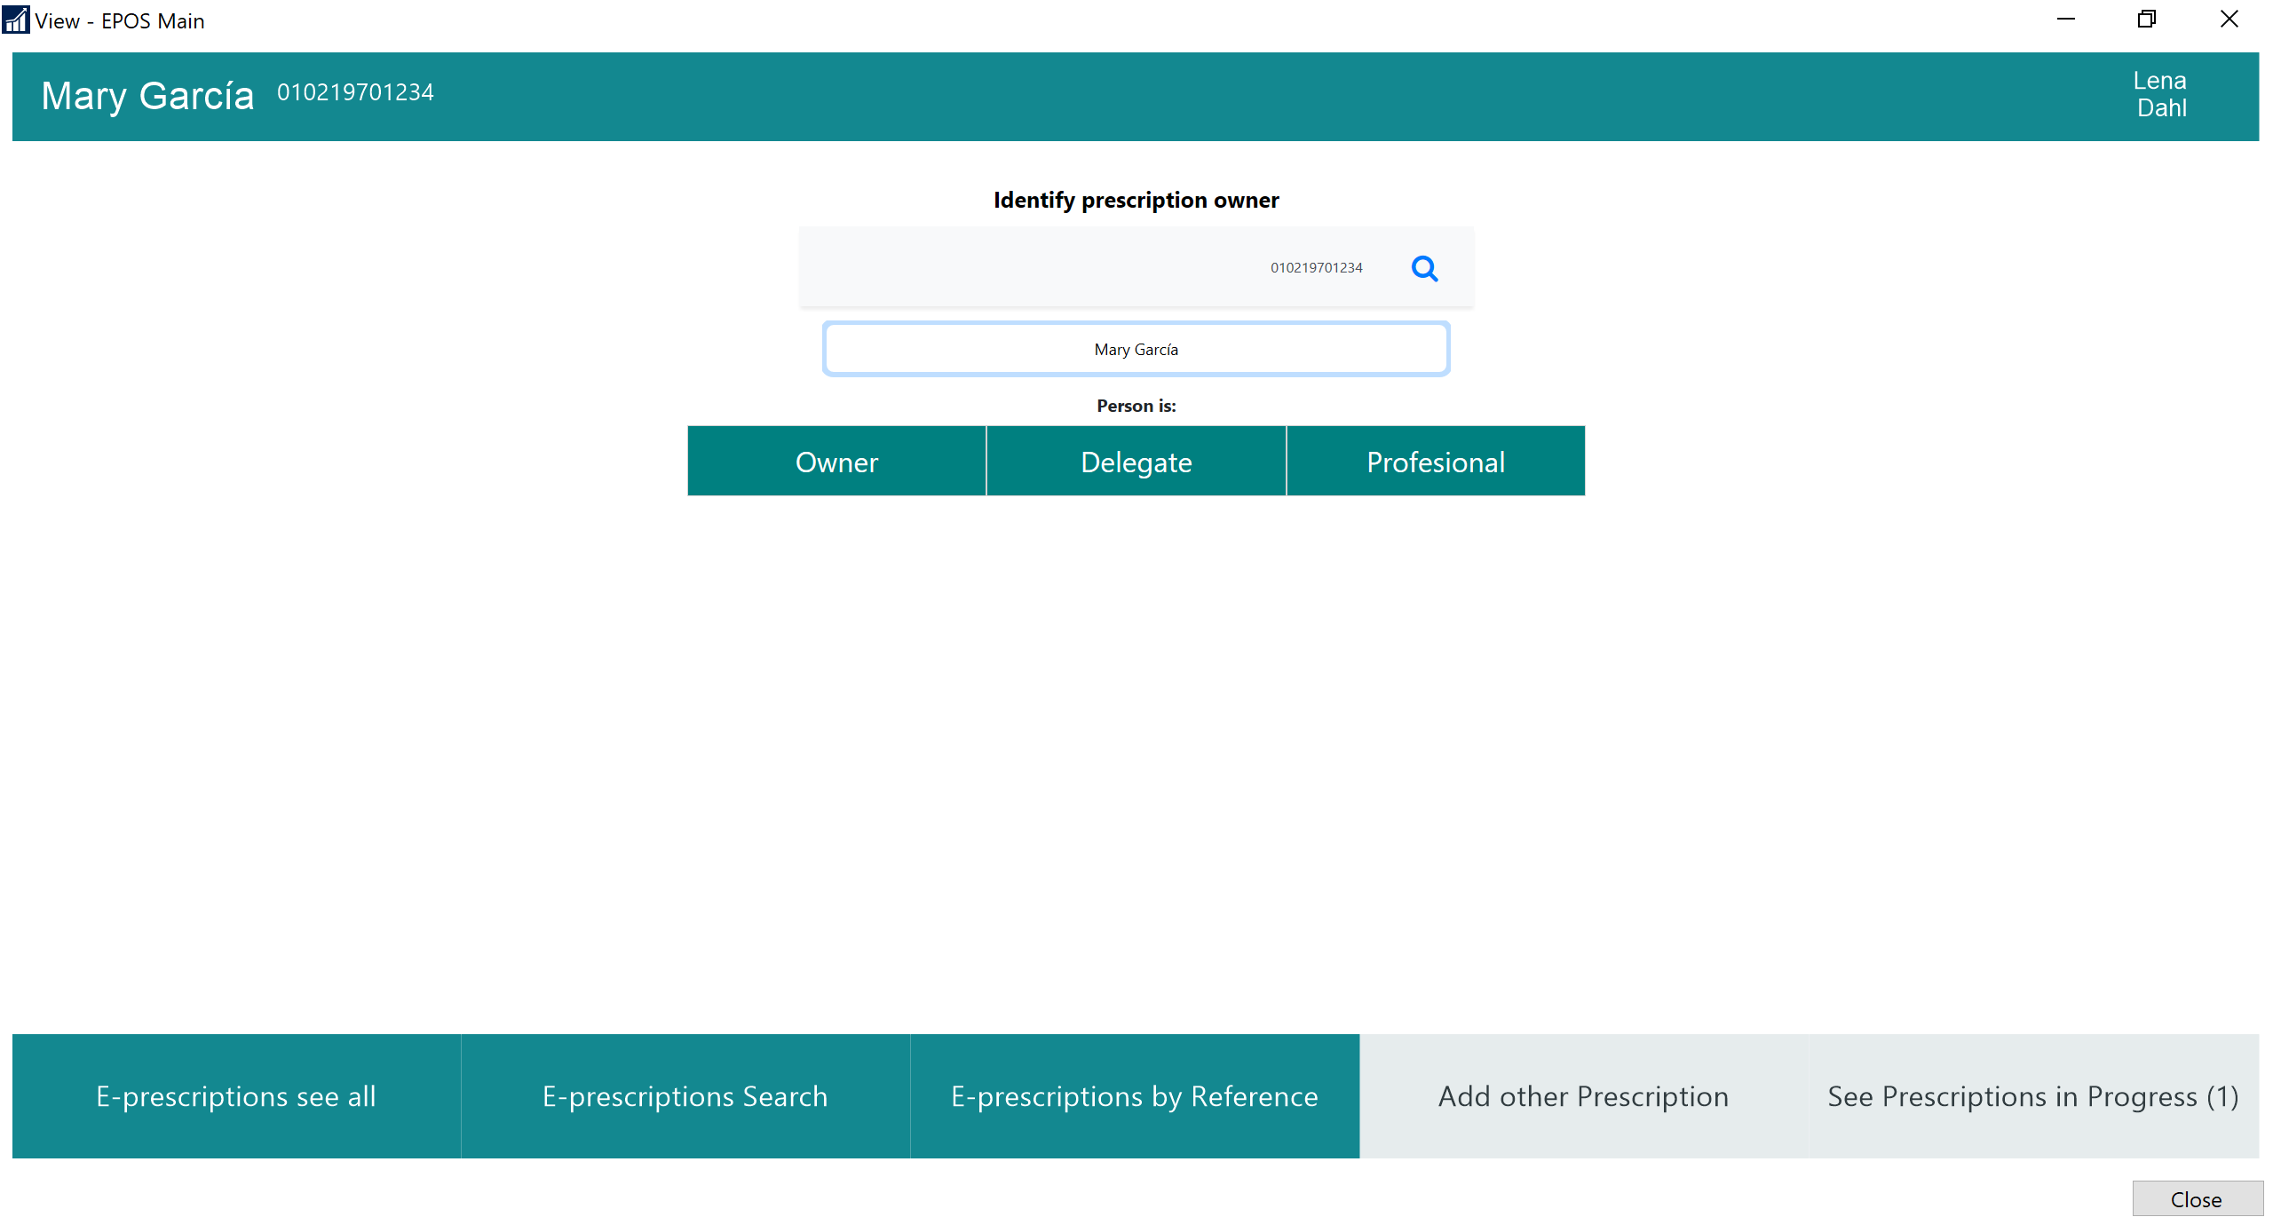

Slide 21
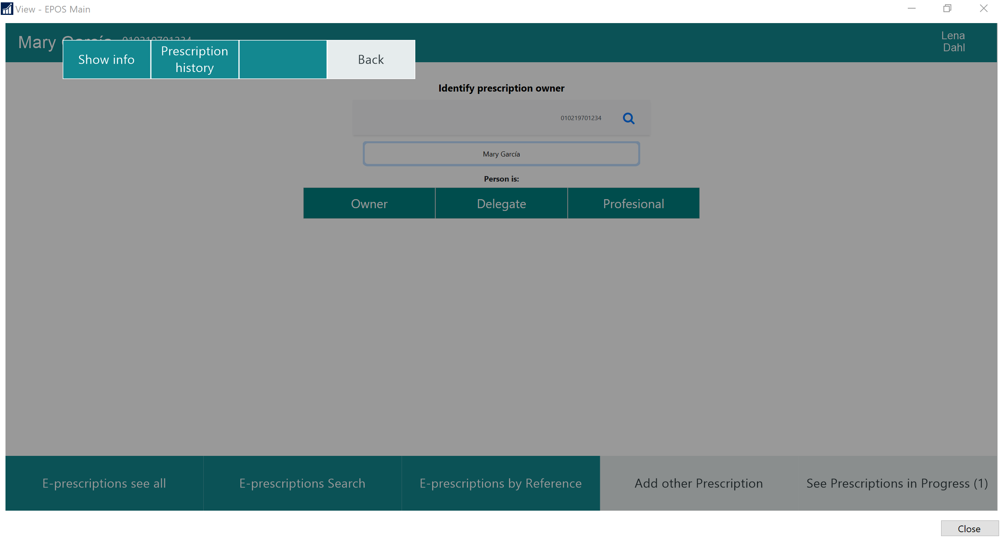

Slide 23
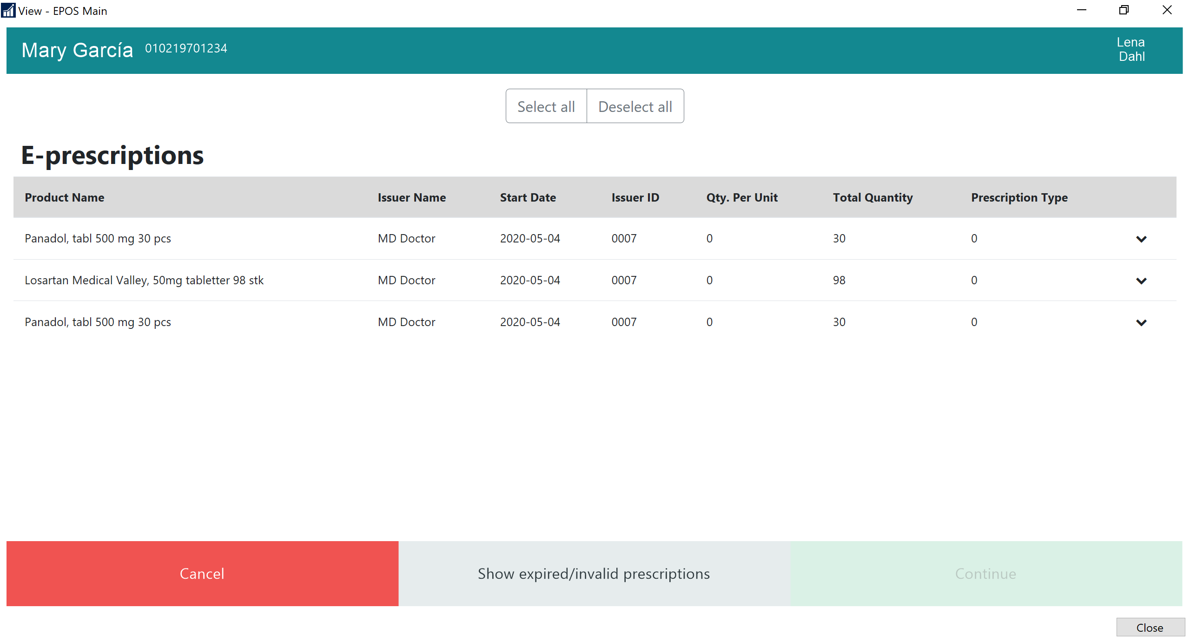

Slide 24
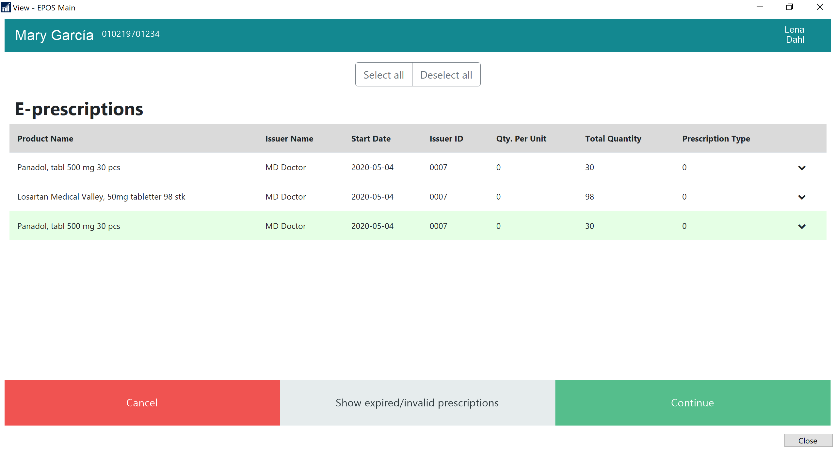

Slide 25
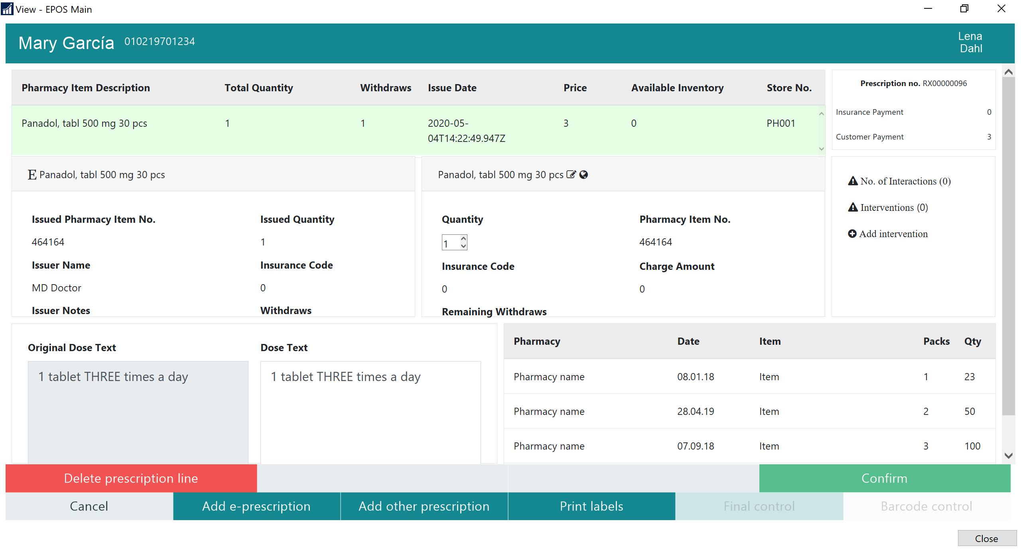

Slide 26
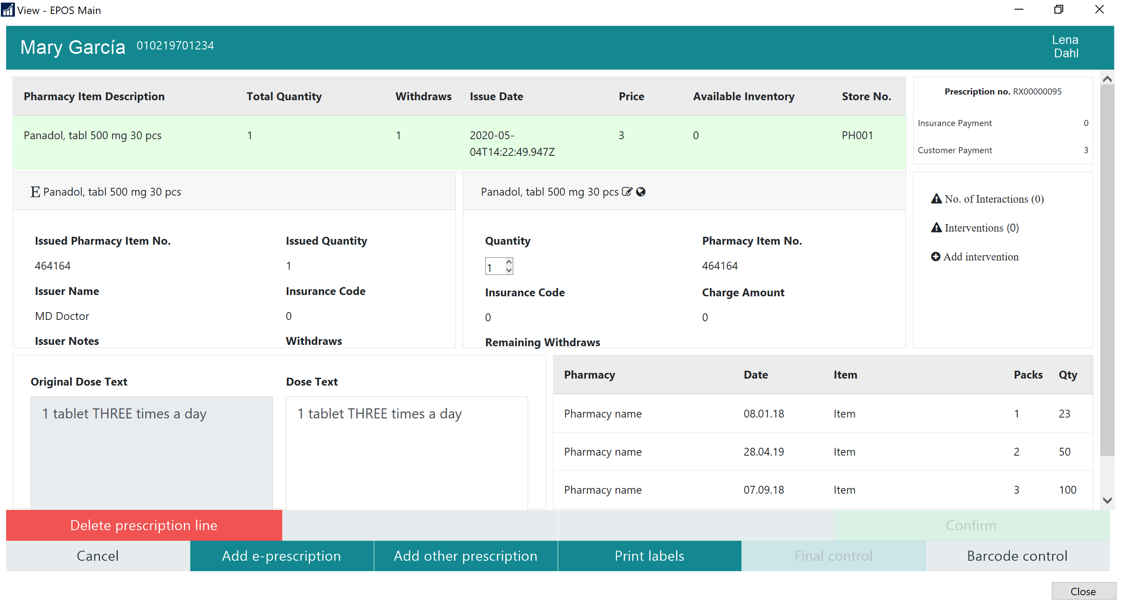

Slide 27
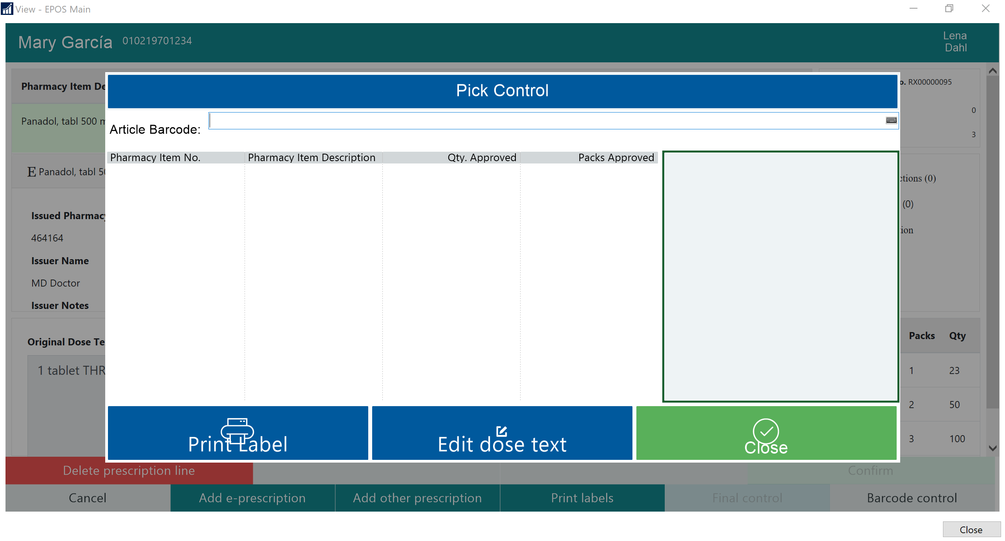

Slide 28
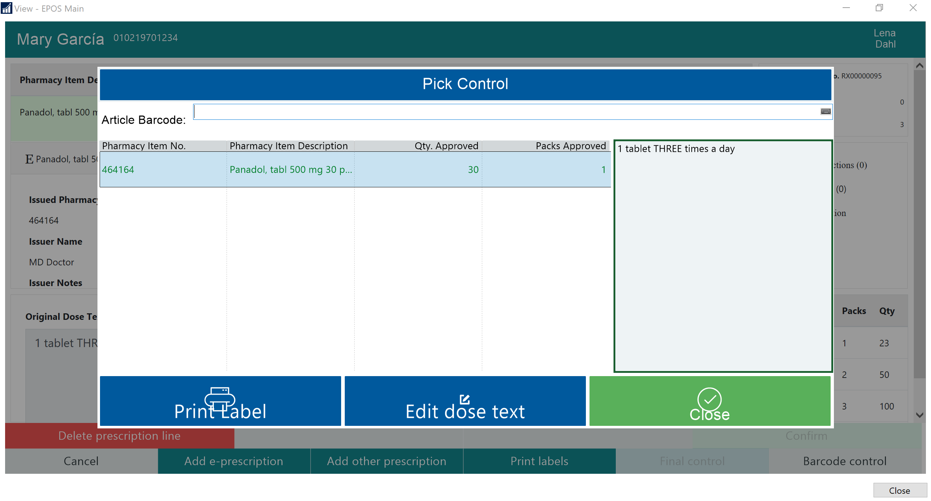

Slide 29
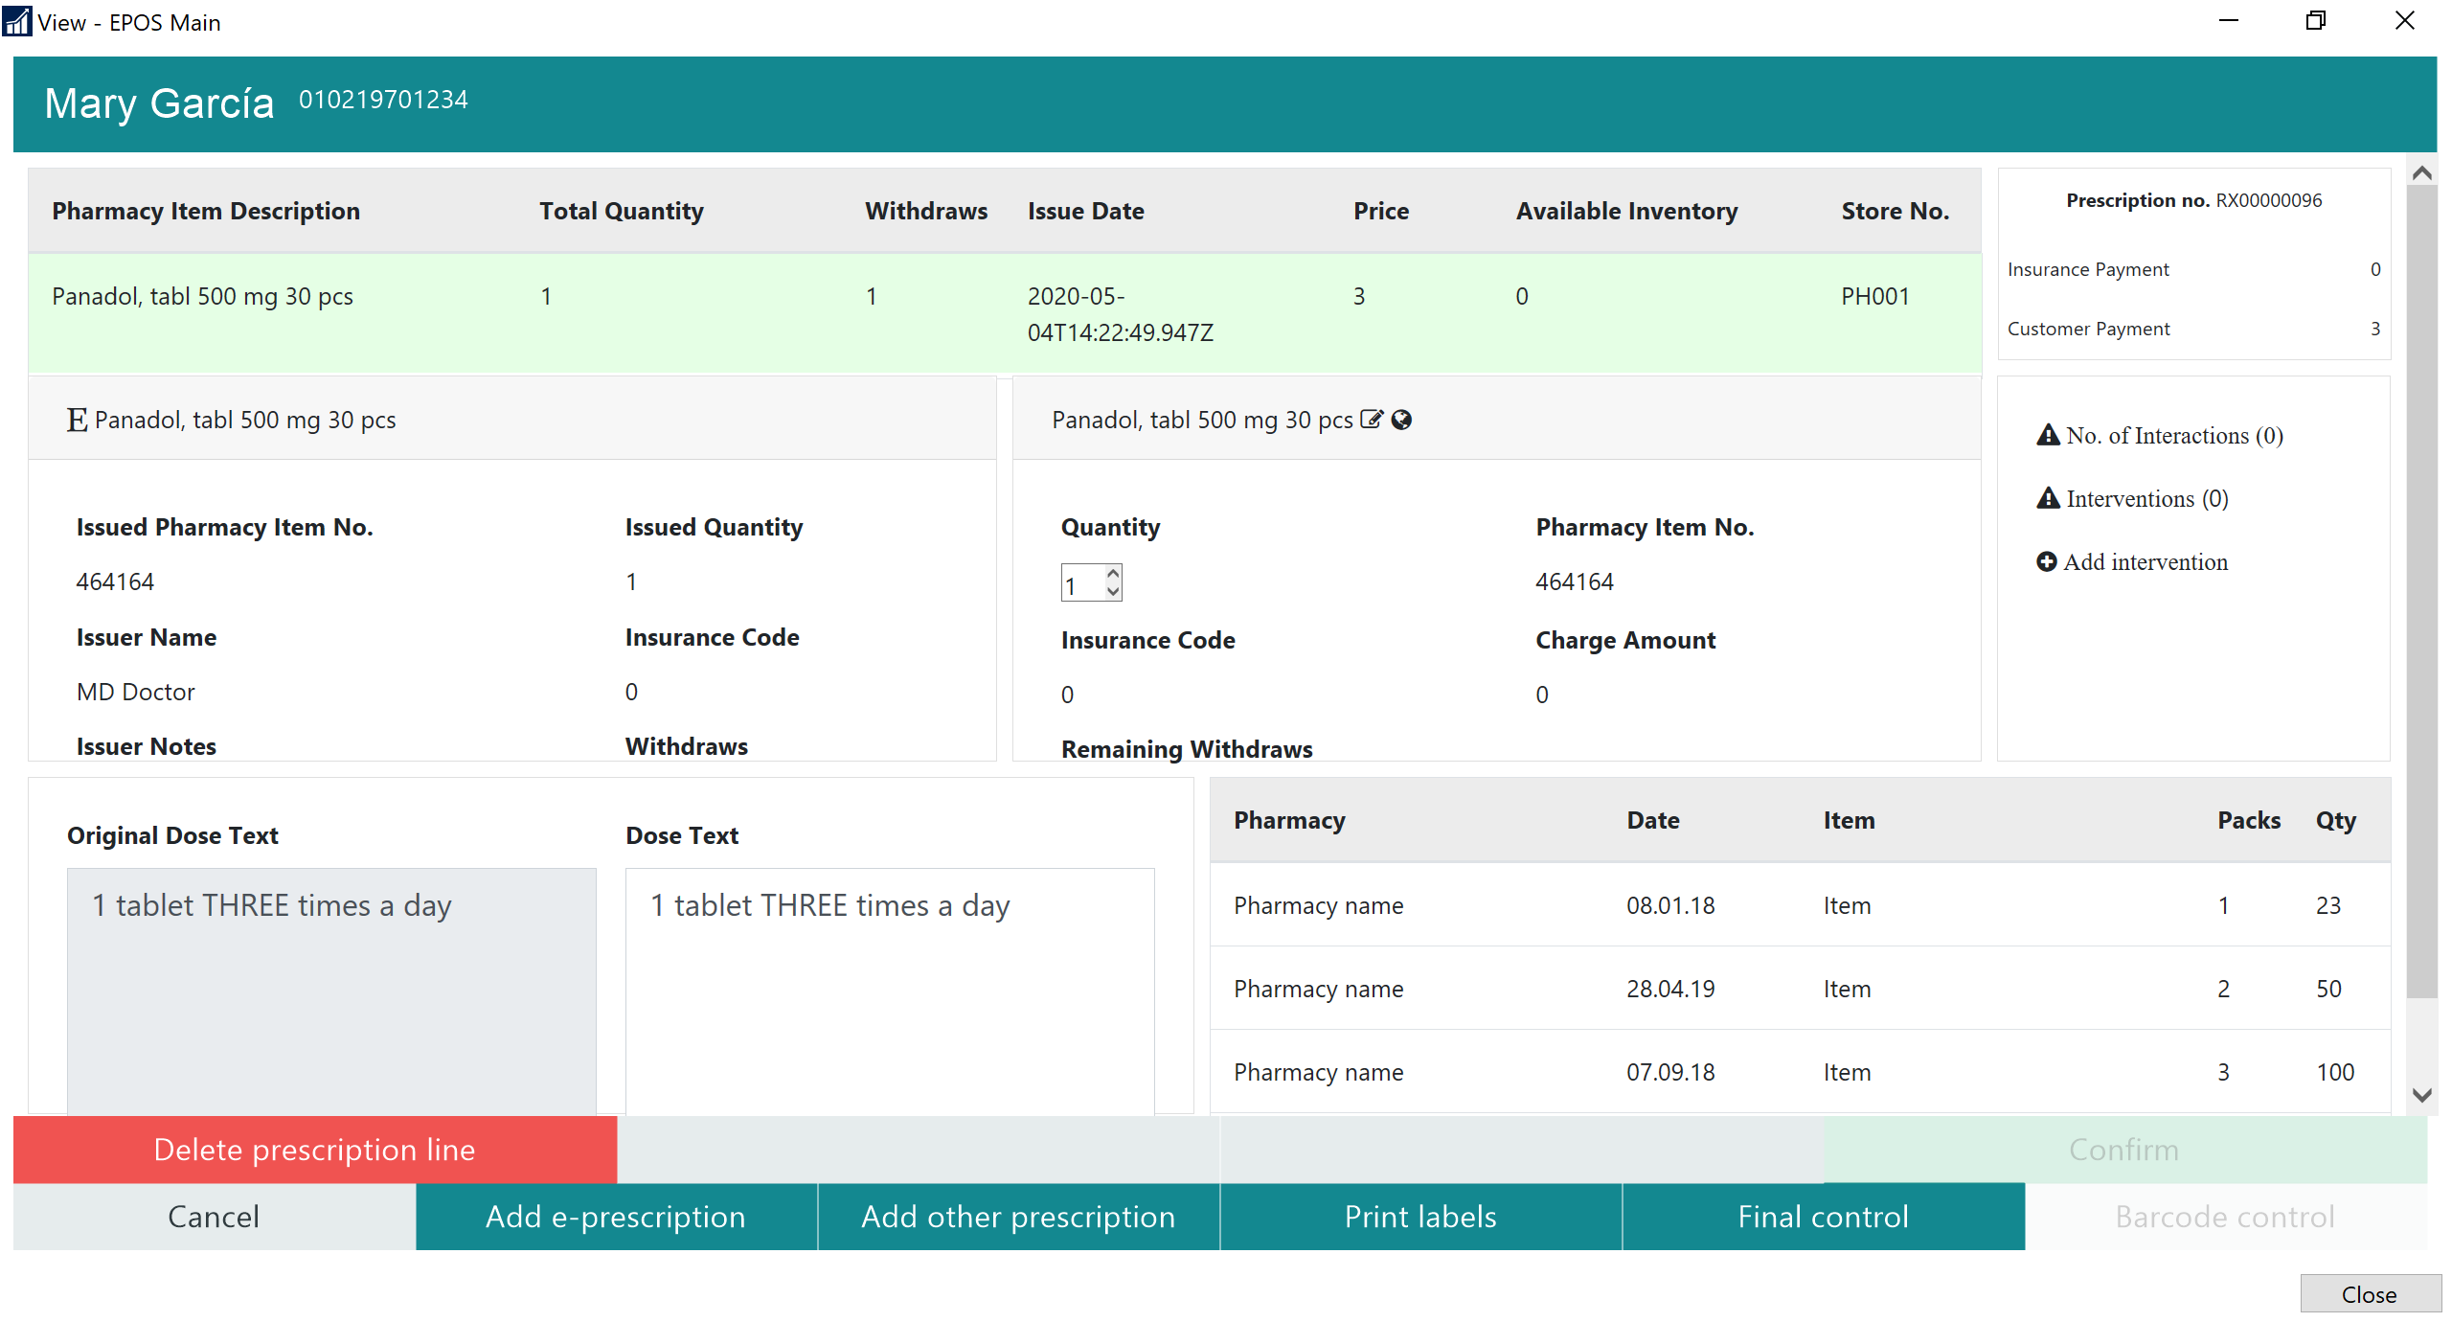

Slide 30
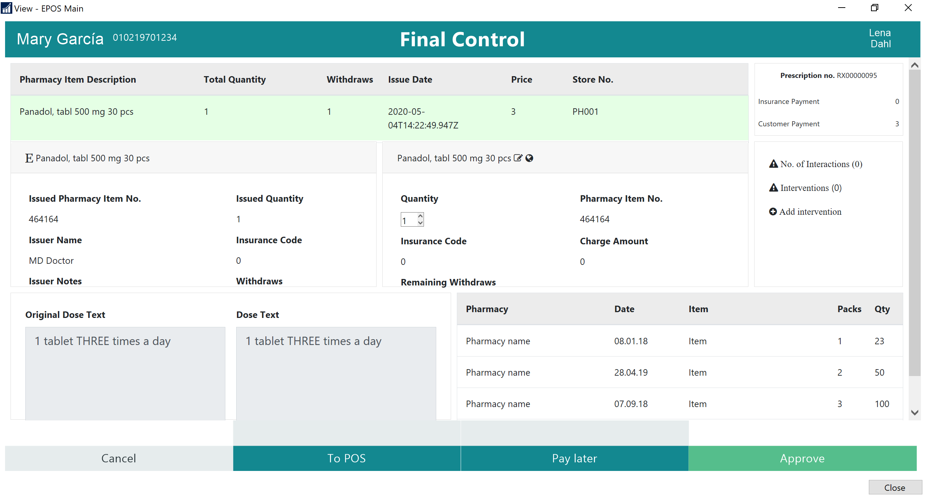

Slide 31
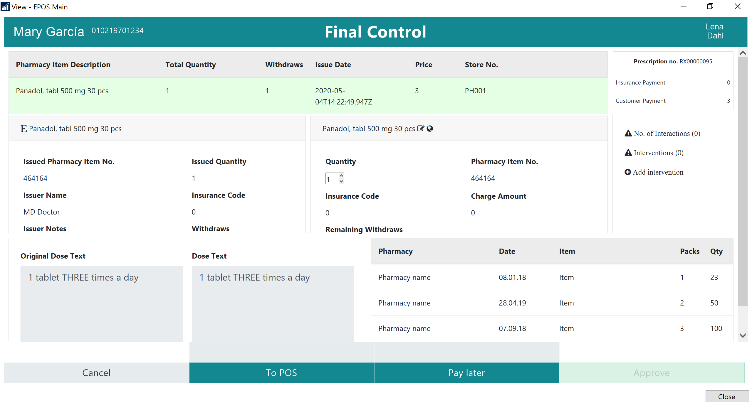

Slide 32
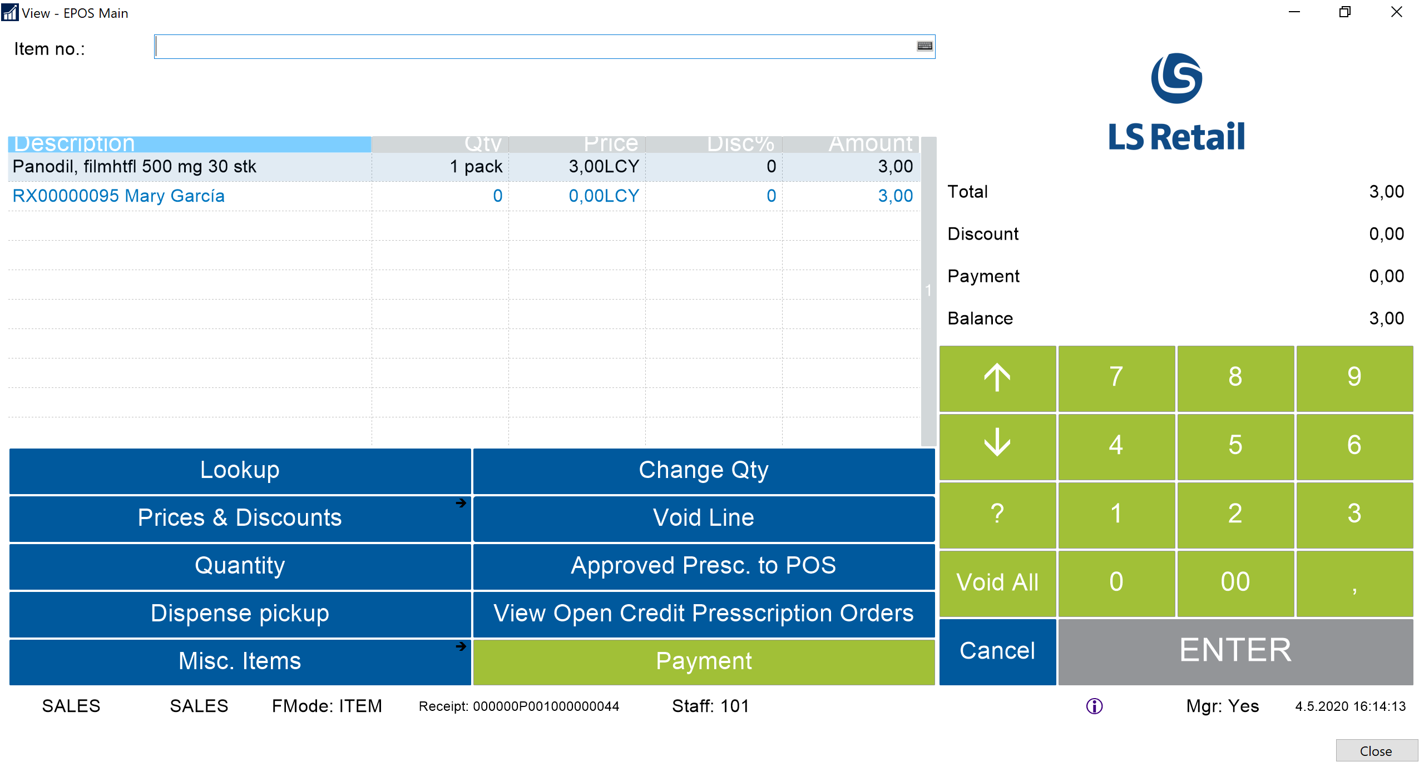

Slide 33
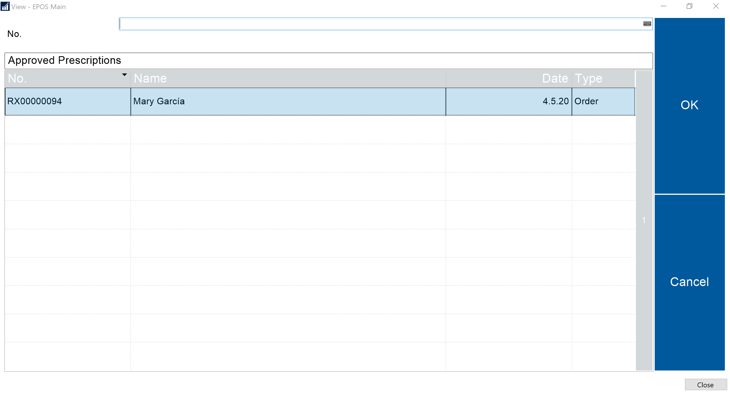

Slide 34
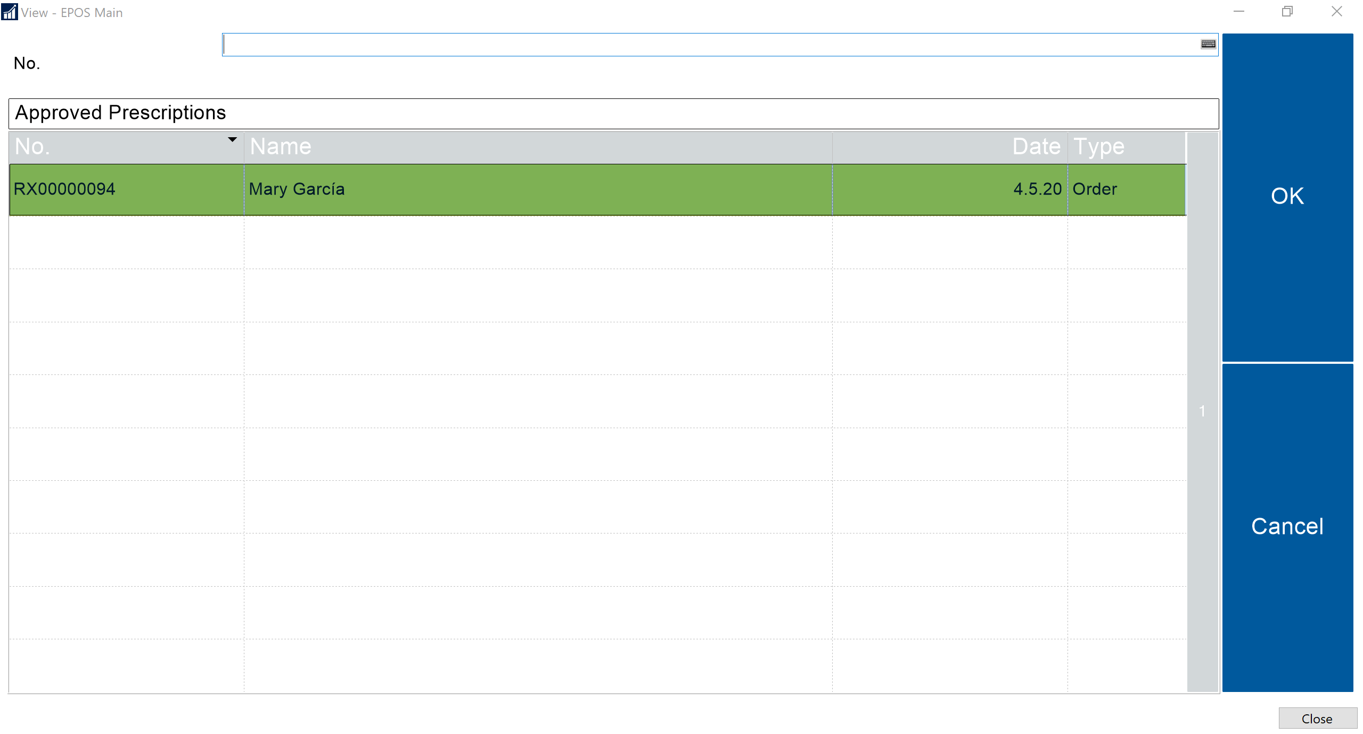

Slide 35
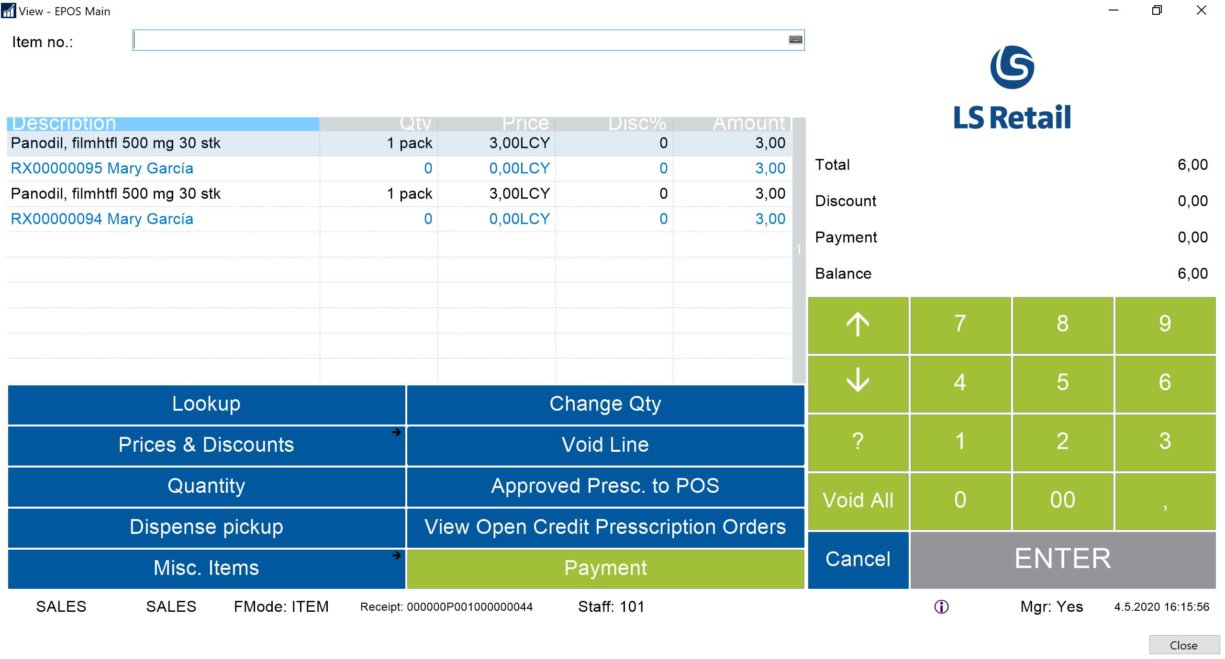

Slide 36
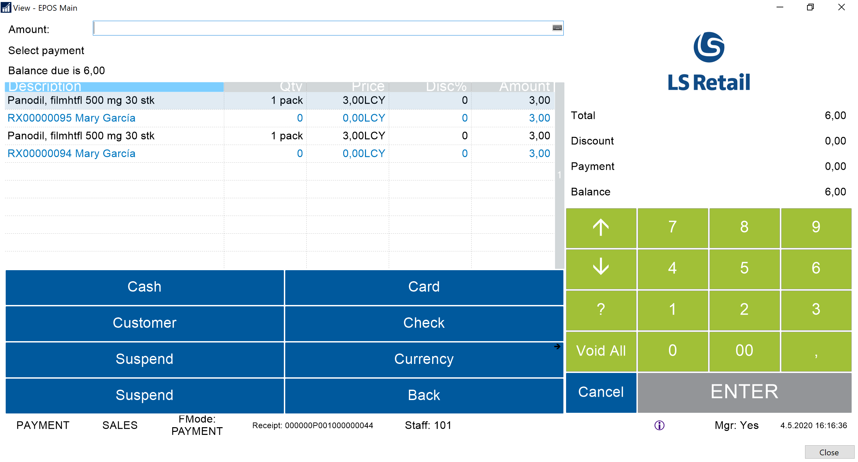

Slide 37
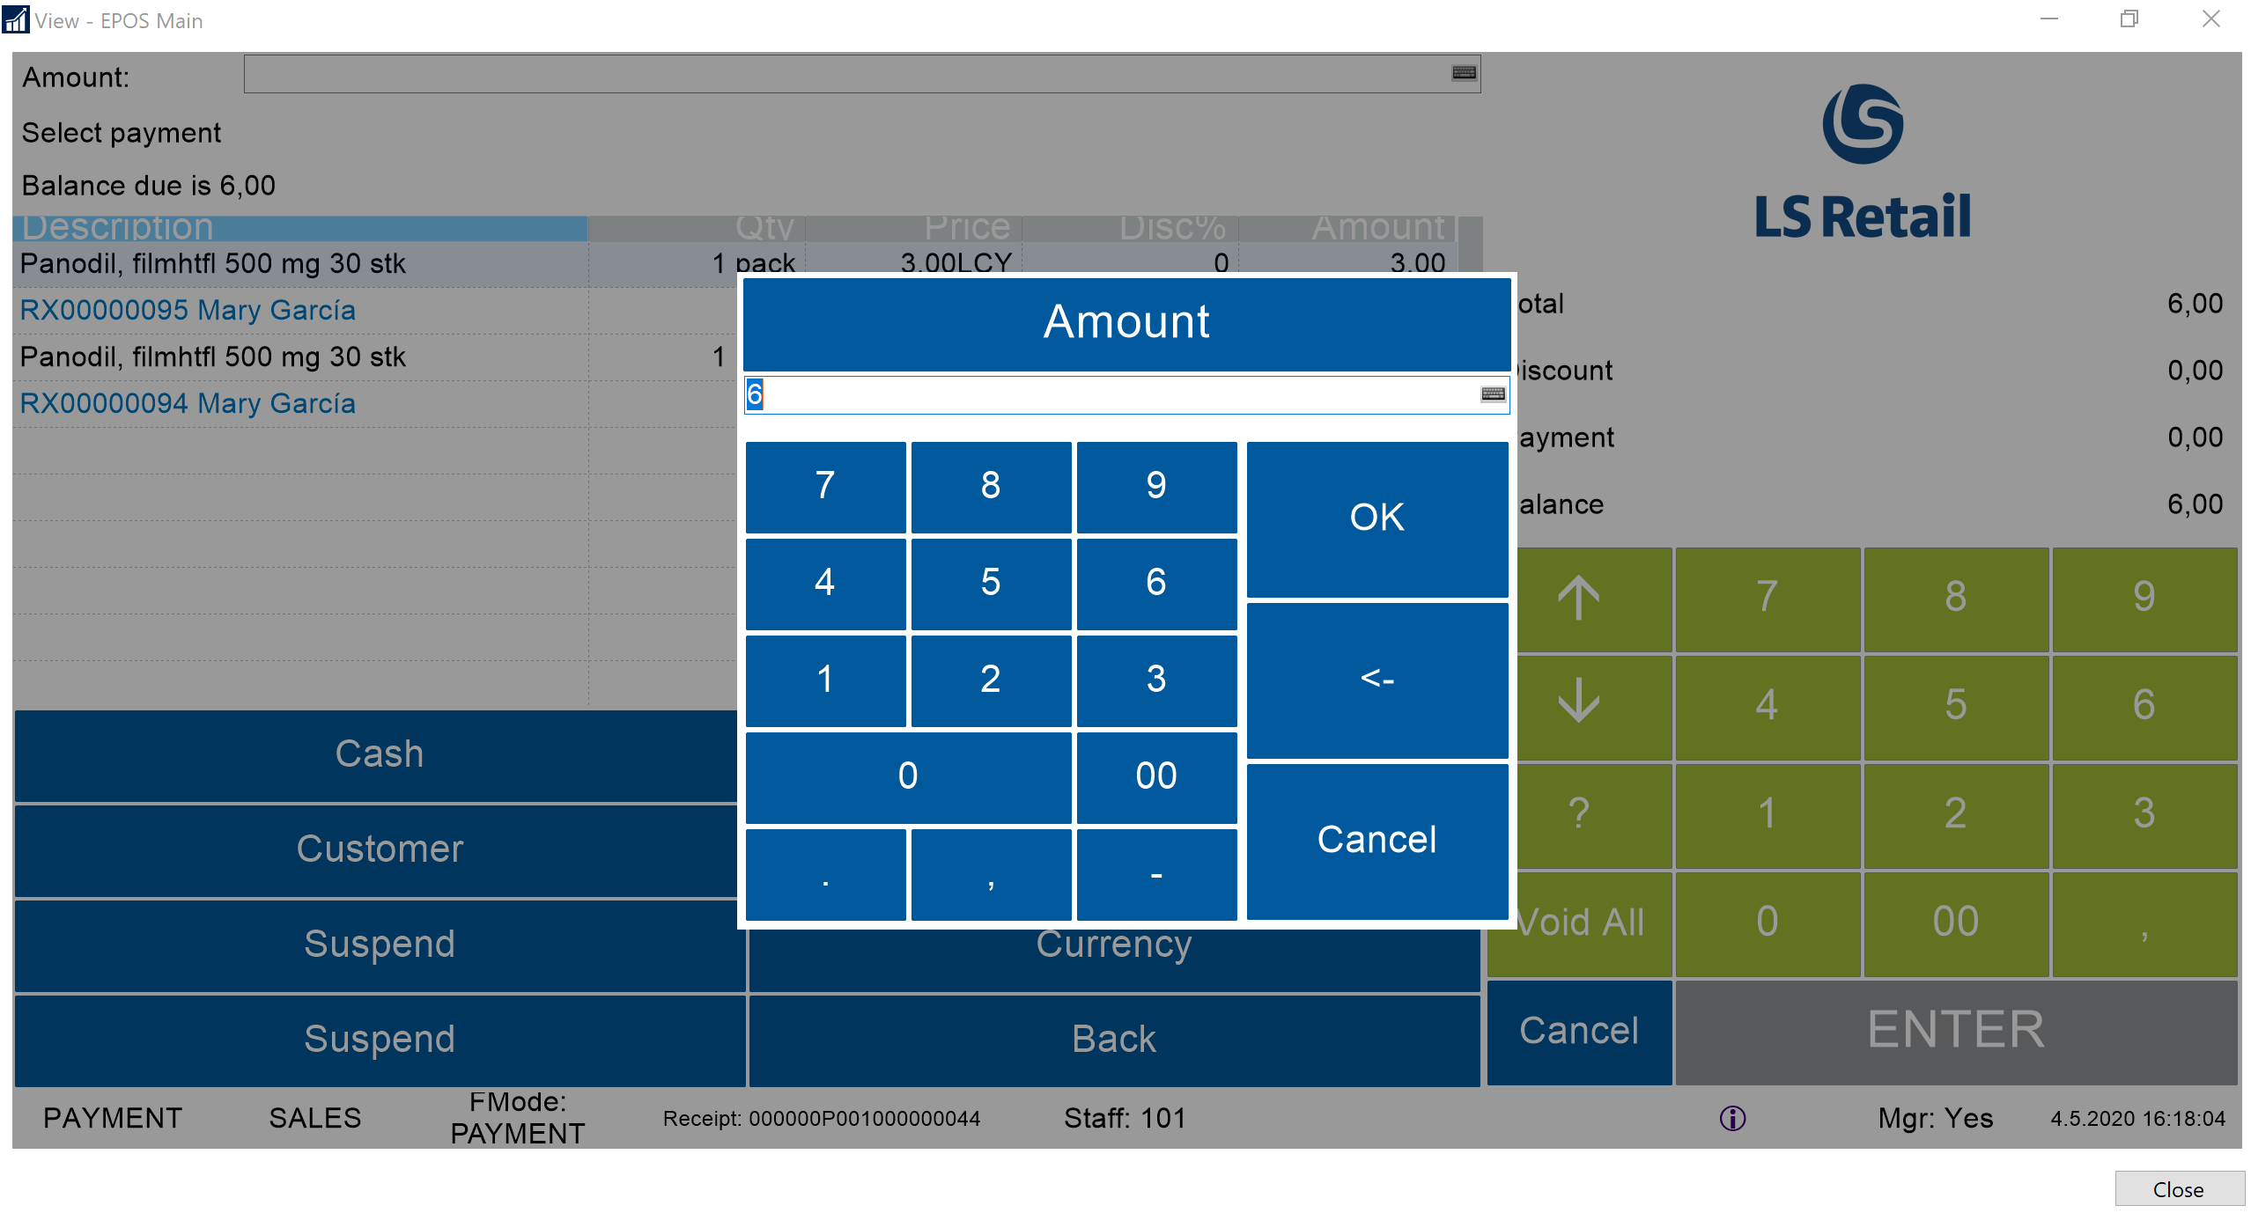

Slide 38
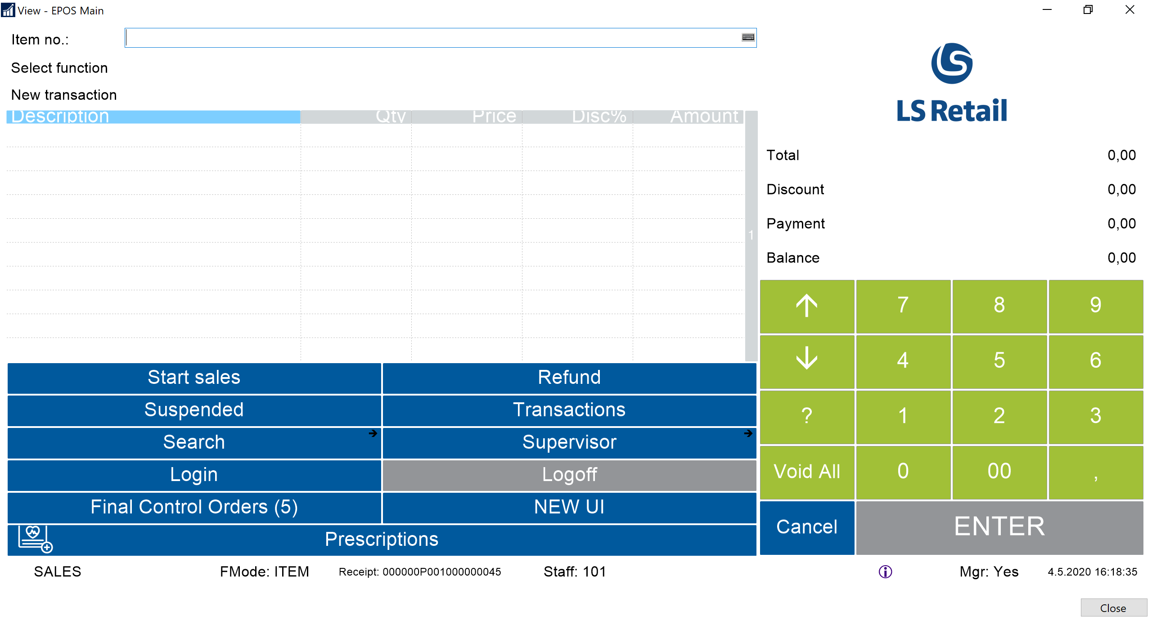

Slide 39
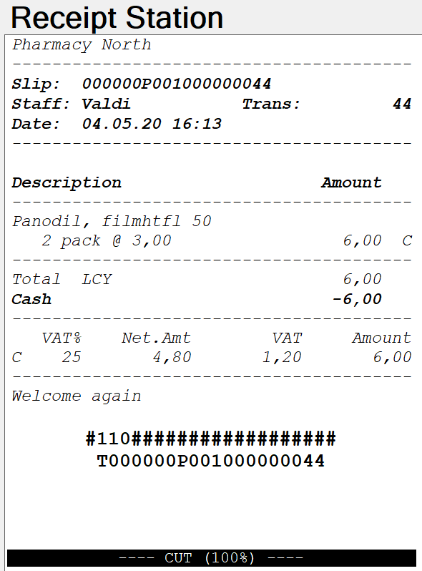

Slide 40
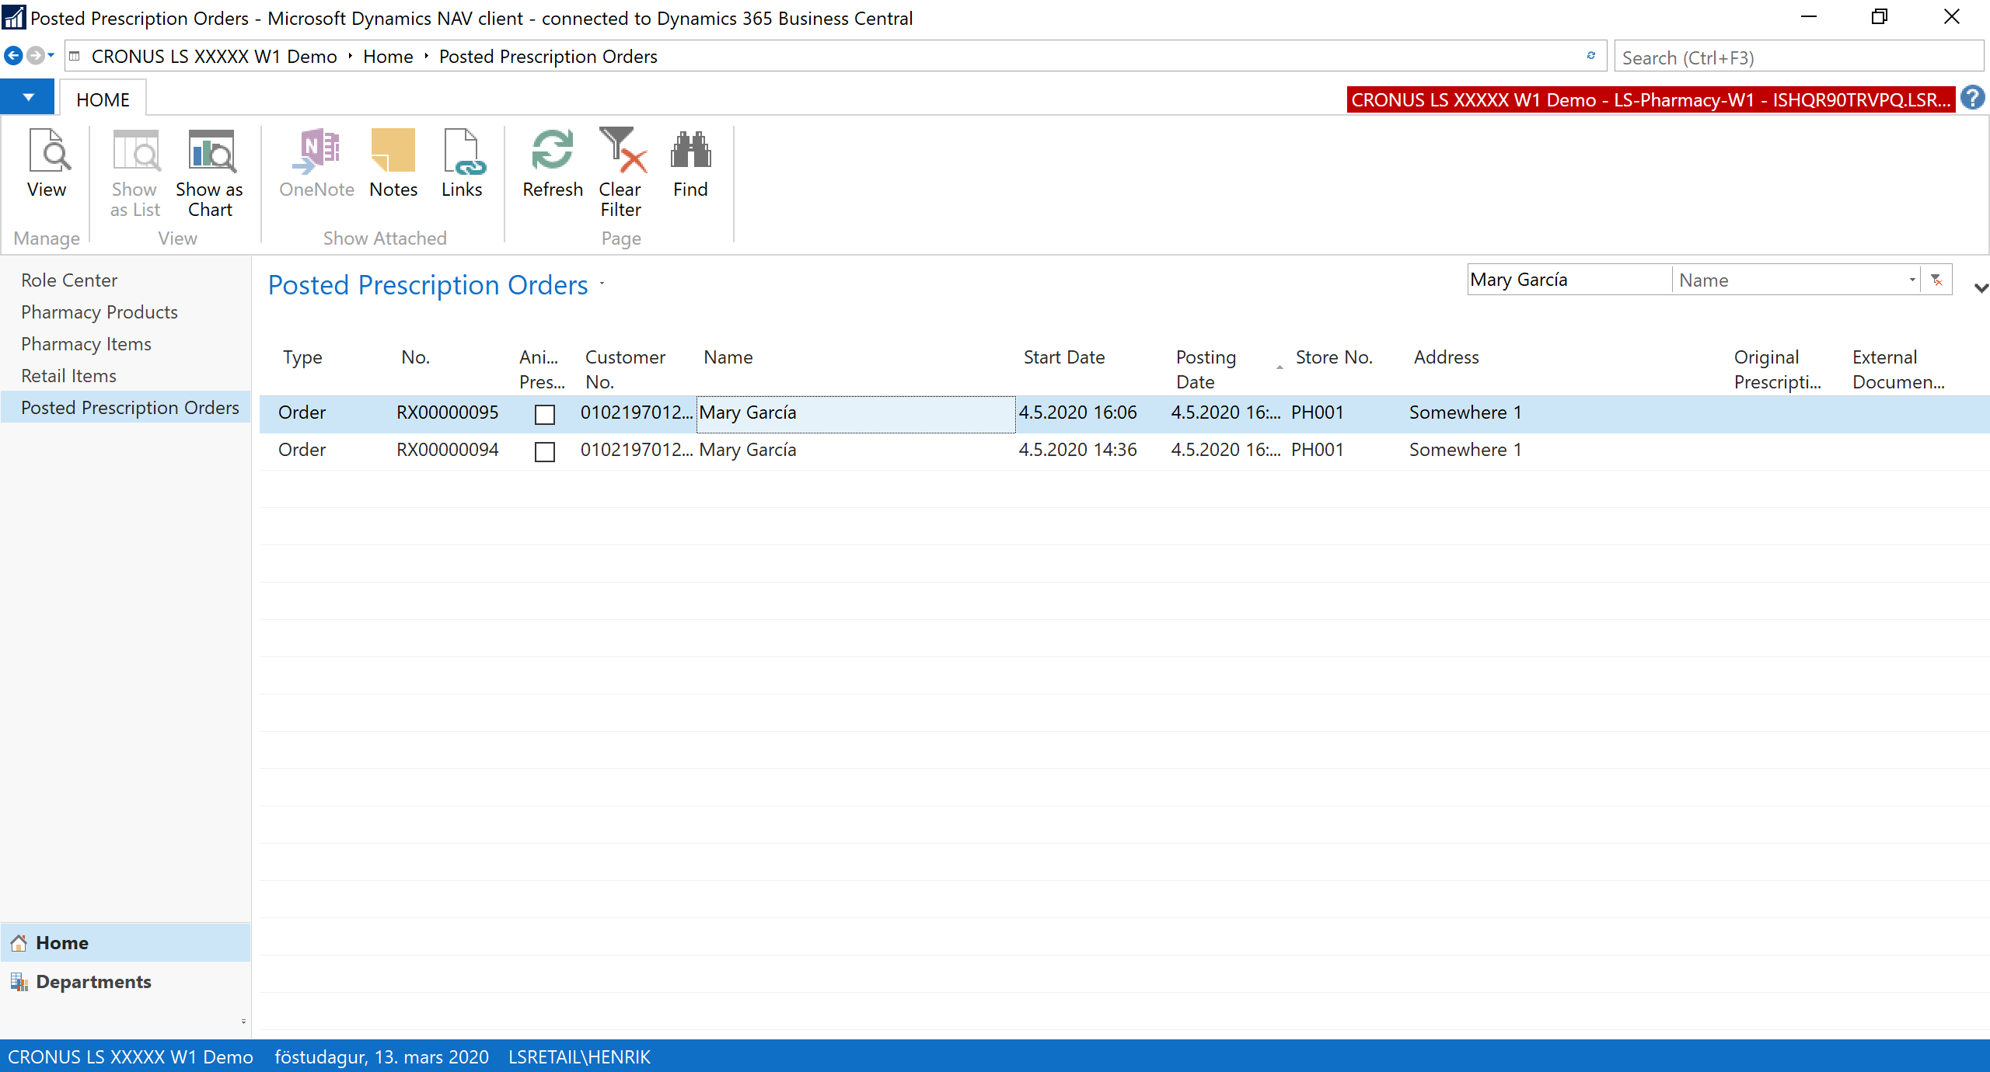

Slide 41
Integrations

Slide 42
Customers of a modern pharmacy
Young families
Active
Chronic illness
Seniors
Simple medications
OTC and Retail items
Frequent visits
Online?
Convenience
Retail items
-Health and beauty
-Nutrition
High income?
Self-service
Online?
Lifestyle related?
Income?
More complex medication?
Regularity / subscriptions
No hurry
Price focus?
Often using multiple drugs and items
Advice
Customer Profile

Slide 43
Online ordering
Advisory role
Health and beauty
Easy check-out
Subscriptions
Services
LS Central for pharmacy

Slide 44
Goal
Possible to handle prescriptions ordered in different channels
Solution
Extend Customer Orders in LS Central to support prescriptions
Pharmacy process is needed before the Customer Order can be delivered and posted
Regular Customer Order posting from POS or Sales Order
Basic web services provided, but some customization to be expected
Connection to e-Prescriptions and insurance either via LS Central or from the customer‘s solution
Unified commerce

Slide 45
Modular design of LS Central and LS Central for pharmacy
Country
Integration
Each component in the system is like a Lego brick with seamless data integration
For customers, this means that it is now possible to update the system without a major upgrade project
Can function as a standalone pharmacy solution or a complete ERP, retail and pharmacy solution
Supports Unified Commerce unifying all channels & running them from the same back-end solution
Member management or loyalty program is integrated part of the solution
LS Central for pharmacy
LS Central
MS Dynamics 365 Business Central
Overview - Lego methodology

Slide 46
People
Pharmacy Customer
Issuer (doctors etc)
Staff
Items
Pharmacy Item and Pharmacy Product
Prescriptions
Prescription Order and Order Line
e-Prescription for integrations
Functions
Payments using POS
Pricing based on LS Central (POS basket calculation)
Subscriptions
Event publishers
Get Customer
Get e-Prescription
Calculate Insurance
Building blocks of LS Central for pharmacy

Slide 47
LS Central for pharmacy
Based on LS Central 14.02
Currently Windows client only
Upgrade to AL in 2021
Around 900 objects
Localizing the solution
Integrate with e-Prescriptions, insurance and customer registry
Item master data import
Implement local rules (reimbursement, generic substitution)
Label printing
Licensing and localization
LS Central + LS Central for pharmacy
Localization is licensed from LS Retail in some markets
Localization consists of
New event subscribers (Codeunits)
Other new functions
New fields in tables
New tables and pages
(10-20) modified pages
Translation
Localizing the solution

Slide 48
Core LS Central for pharmacy
Identify customer Ask for Present Download e-Prescriptions List single e-Presc
LS Localization
Subscriber Response Subscriber Request Request
External Web Service
Get Send List Lock Presc. e-Prescriptions
Example: e-Prescription

Slide 49
With LS Central for pharmacy you can:
Handle all daily routines in a pharmacy - from back office to POS
Manage various types of prescriptions and handle drugs effectively
Keep track of your stock across all stores and do replenishment
Search products and packaged items based on various parameters
Manage user-access and permissions
Define your own user interface in a modern way
Govern the data structure for medications and efficient handling of pharmaceuticals
Have a fully integrated dispensing, Retail and ERP solution in ONE software suite and/or decide which areas to use
Get access to many add-on solutions like for activity, staff management and rostering
Rely on a standard Microsoft & LS Retail Platform securing a modern and future proof solution
Use international and modular solution which can be used in multiple countries
Summary - Why LS Central for pharmacy?

