Slide 2
Guðrún Ólafsdóttir (Gúa)
LS Core -> LS Central Implementation Guidelines
How to successfully implement LS Central
Product Director and Development Manager
gua@lsretail.com

Slide 3
LS Core?
Go Current?

Slide 4
New name
LS Core
LS Central Implementation Guidelines

Slide 5
Our vision
Our vision is to continuously deliver rapid and guided user experience

Slide 6
Values
Empathy
Clarity
Efficiency
([ˈiːzi])

Slide 7
Our Methods
Define the core
Create a base structure that is easy to maintain and plug in additional features and implementation types.

Slide 8
Let’s have a look
Notes:
.

Slide 9
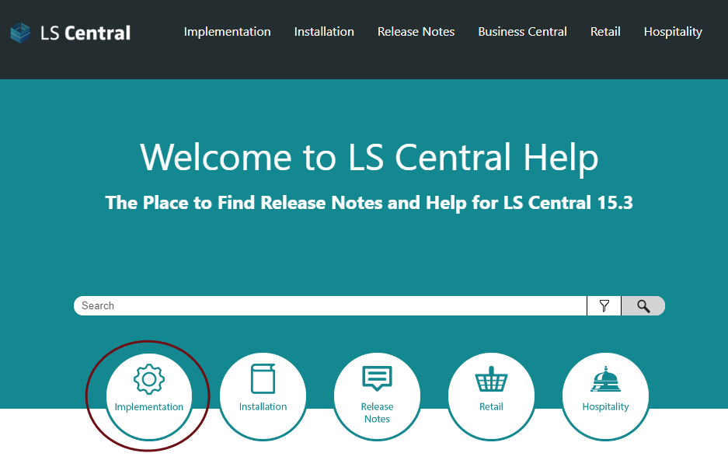
https://help.lscentral.lsretail.com/Content/home.html

Slide 10
Implementation guide

Slide 11
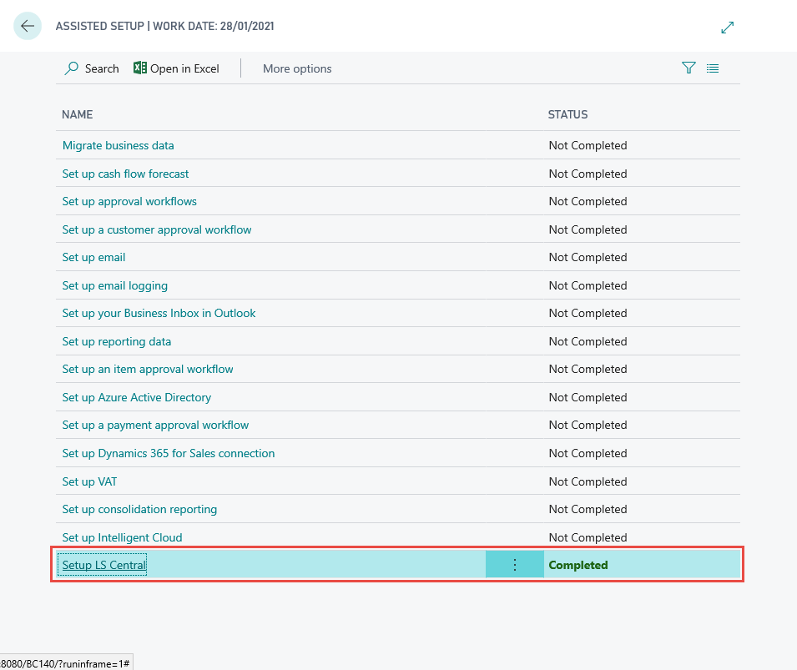
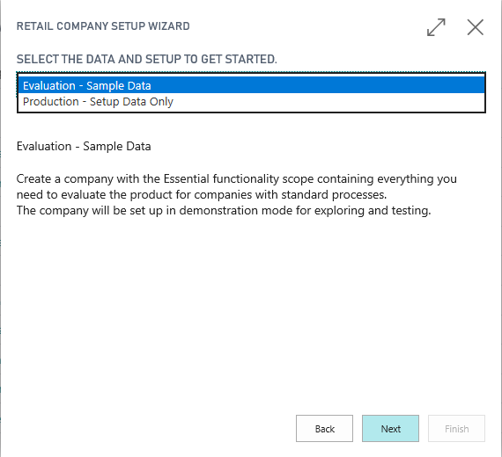
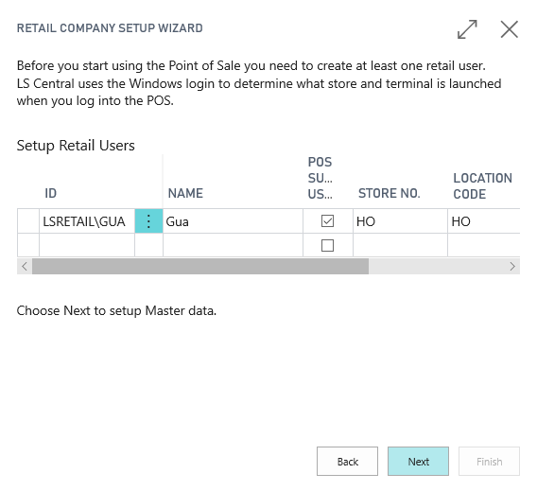
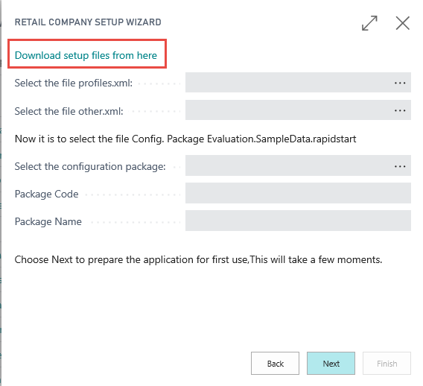
Assisted Setup
Notes:
.

Slide 12
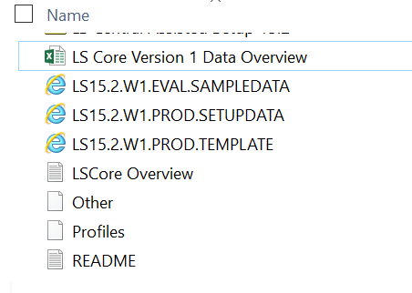
Data packages
Evaluation – sample data
Production – setup data
POS profiles and setup

Slide 13
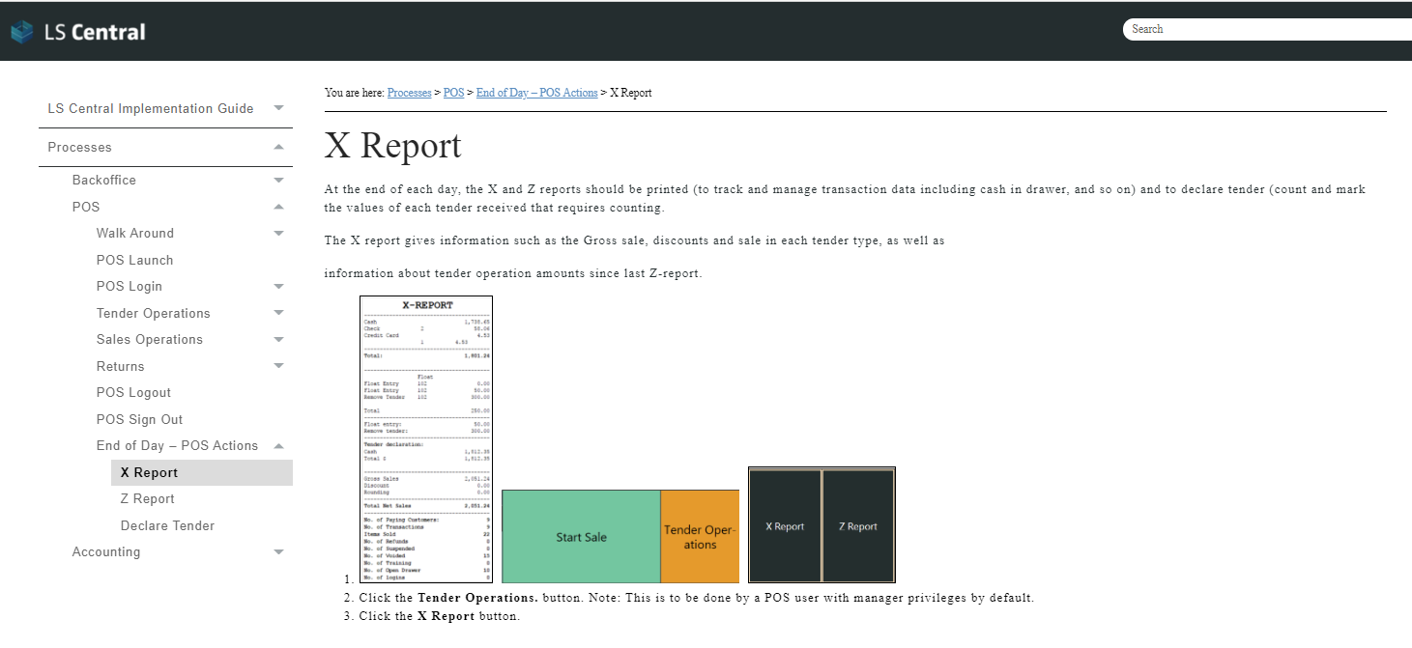
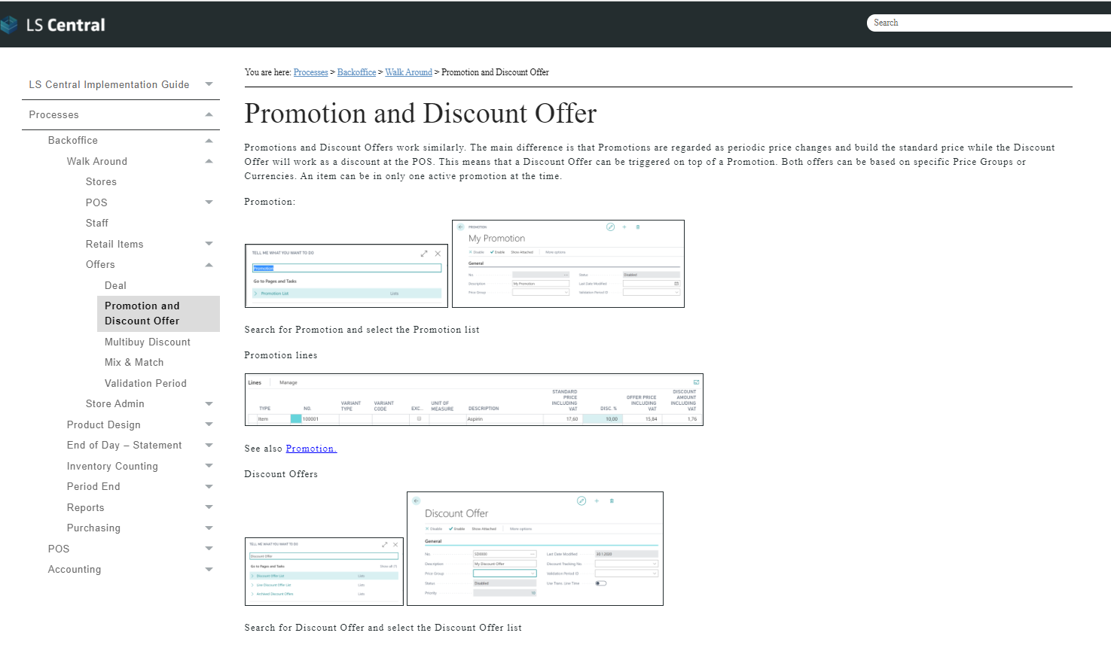
Training material

Slide 14
Business
overview
Best Practices
Implementation plan
Installation and configuration
Data setup and configuration
Processes
Purpose
This guide is to provide an outline used to implement LS Central. This includes recommended timelines, package table data and import methods as well as important criteria when implementing areas of LS Central.
This information is provided for informational purposes in relation to the implementation considerations for LS Central

Slide 15
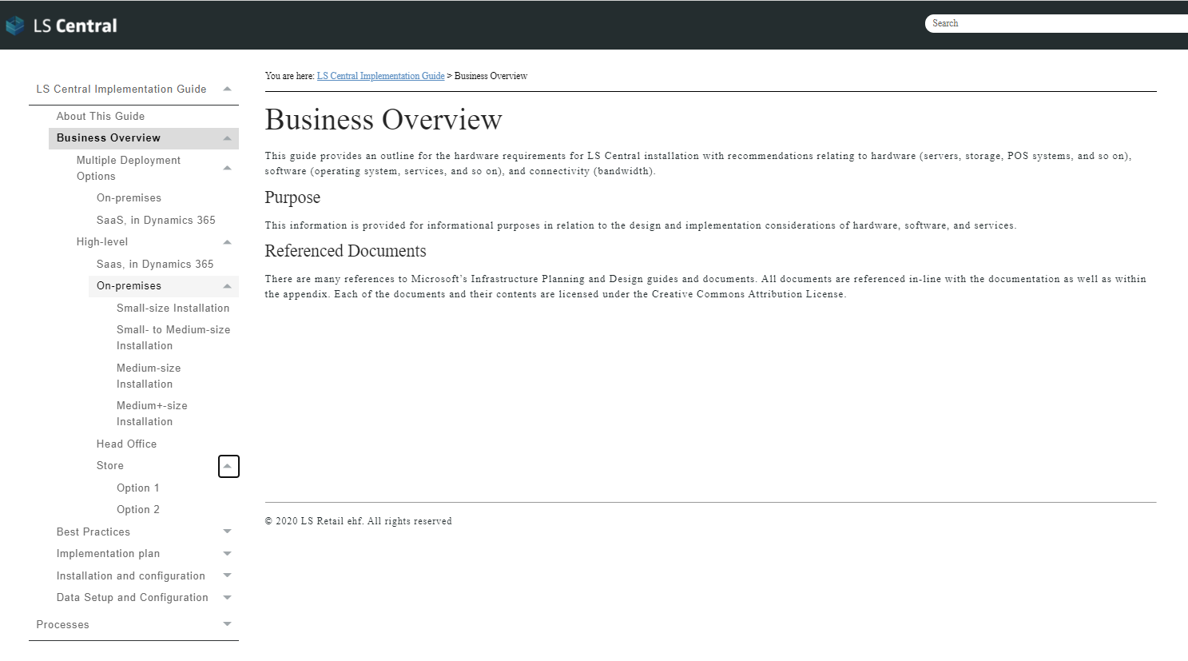
Business
overview
Best Practices
Implementation plan
Installation and configuration
Data setup and configuration
Processes

Slide 16
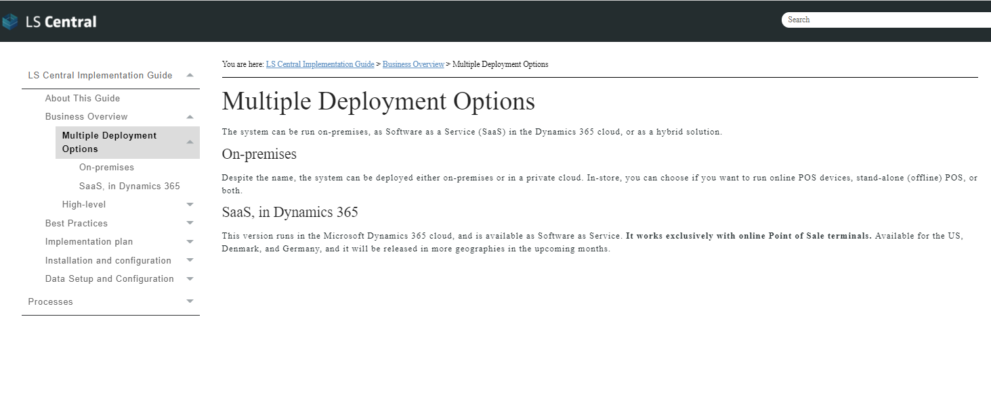
Business
overview
Best Practices
Implementation plan
Installation and configuration
Data setup and configuration
Processes

Slide 17
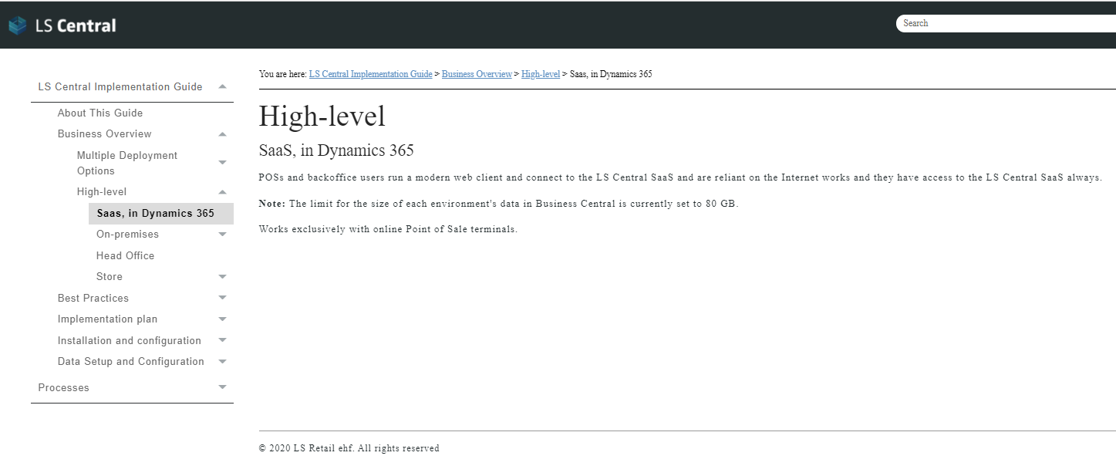
Business
overview
Best Practices
Implementation plan
Installation and configuration
Data setup and configuration
Processes

Slide 18
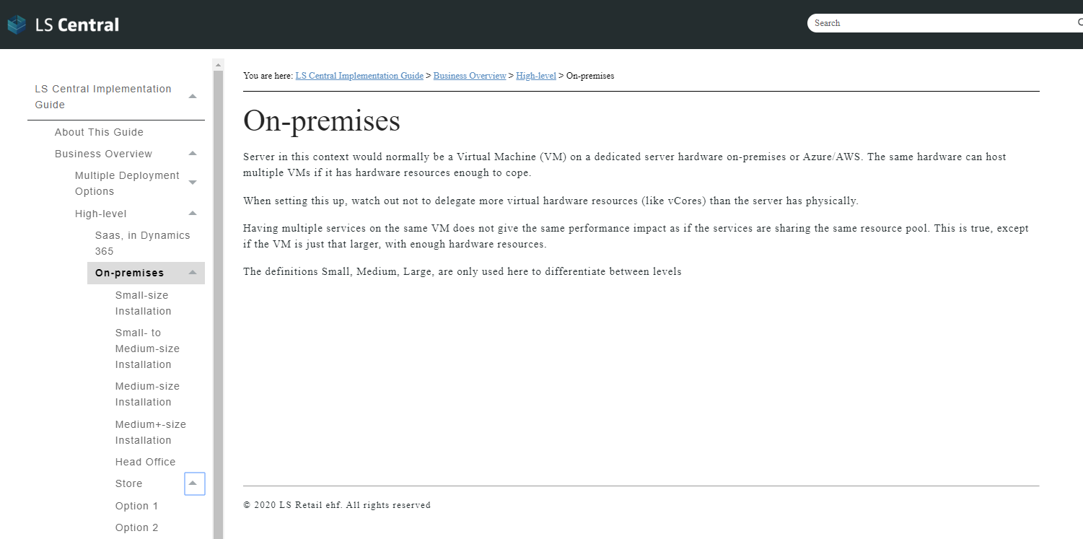
Business
overview
Best Practices
Implementation plan
Installation and configuration
Data setup and configuration
Processes

Slide 19
Business
overview
Best Practices
Implementation plan
Installation and configuration
Data setup and configuration
Processes
High level overview
Everything can reside on the same server, both Microsoft SQL Server (SQL), Microsoft Dynamics Service Tiers (NST), LS Data Director (DD) and Microsoft IIS (IIS)
On – premises
Small Size Installation
Small to medium size installation
Medium size installation
Medium + size installation
The definitions Small, Medium, Large are only used here to differentiate between levels
To increase performance the first added server would normally split the SQL and the NST between servers.
Taking the DD out to separate server, gives the SQL more room to operate.
Splitting up NSTs would normally be next way to go, this would normally be the Client service tier and/or the SOAP tier. When you cannot define which service tier you want to utilize, like from Omni to SOAP, you should use Load Balancer (LB) in front of the service tier. In that way, Omni would talk to the LB and the LB would distribute the traffic between SOAP NSTs, normally by round robin method.

Slide 20
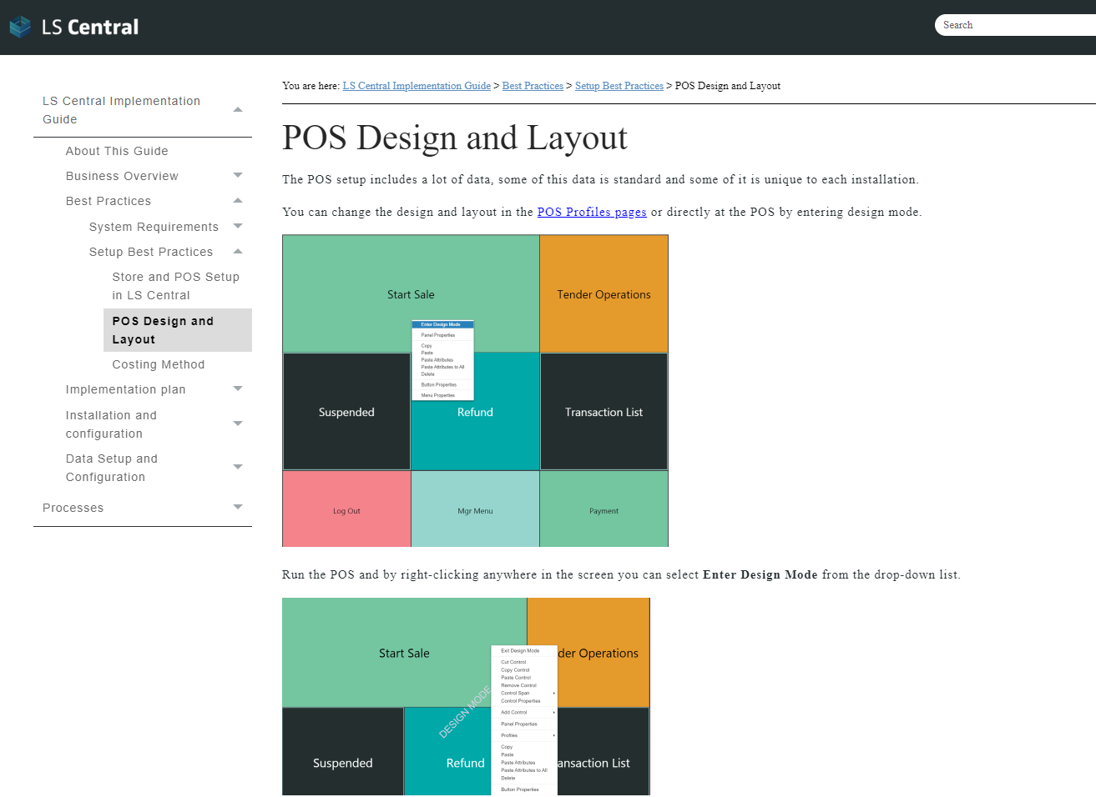
Business
overview
Best Practices
Implementation plan
Installation and configuration
Data setup and configuration
Processes
System requirements
LS Retail recommendations
Microsoft system requirements and best practices
Setup best practices
Store and POS setup POS design and layout
Costing Methods

Slide 21
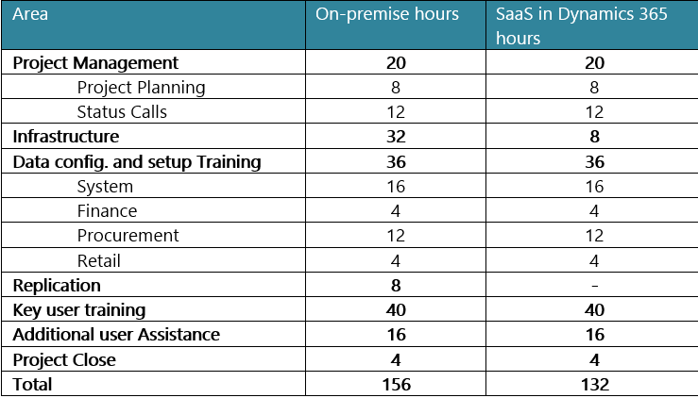
Business
overview
Best Practices
Implementation plan
Installation and configuration
Data setup and configuration
Processes
To implement LS Central, the system must be configured, users to be trained on data configuration and core processes as well as project management tasks.
The total amount of time estimated to implement LS Central using preconfigured packages is 156/132 hours using the following breakdown:
Note: that all timelines are assumed using the standardized chart of accounts included in the preconfigured data packages. If a custom chart of accounts is required, the timelines will increase due to the training
and configuration required.

Slide 22
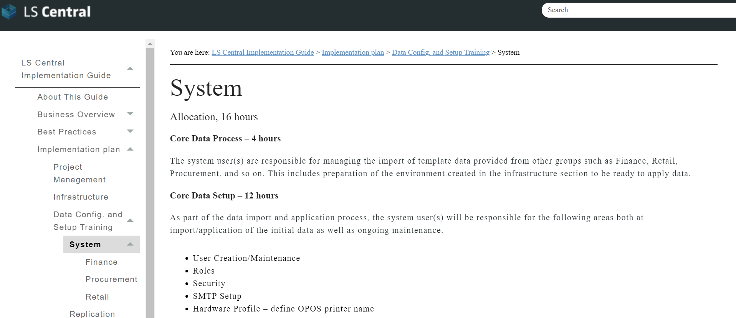
Business
overview
Best Practices
Implementation plan
Installation and configuration
Data setup and configuration
Processes

Slide 23
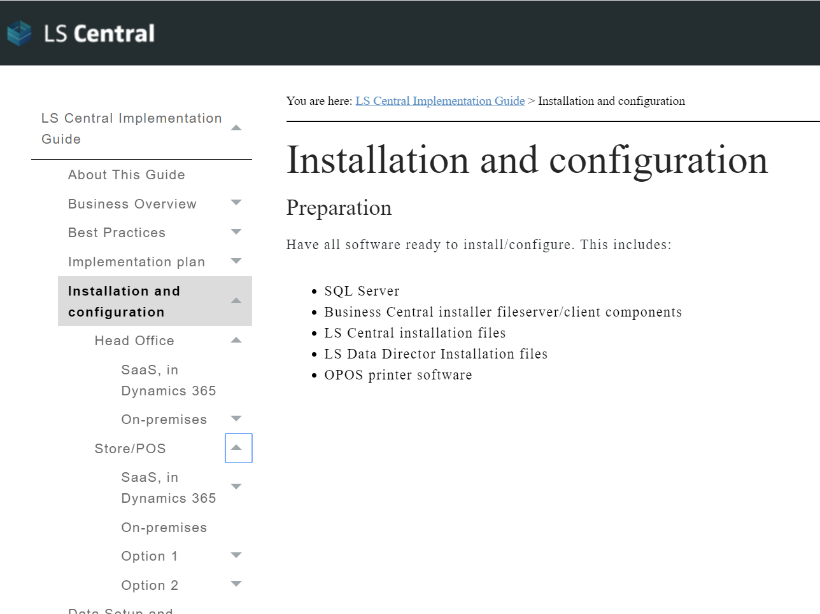
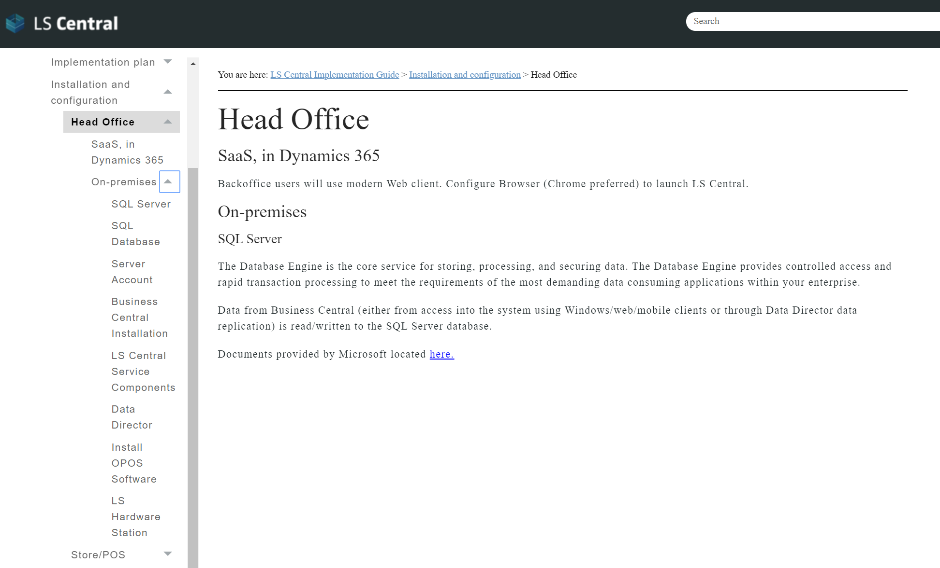
Business
overview
Best Practices
Implementation plan
Installation and configuration
Data setup and configuration
Processes
Notes:
N

Slide 24
Business
overview
Best Practices
Implementation plan
Installation and configuration
Data setup and configuration
Processes
In Excel Worksheet “Production” you will find a list of Business tables and data included in the Production data package.
All timelines in the Implementation plan section are assumed using the data package provided.
If custom packages are used the timelines could increase due to training and configuration required.
Advanced:
Excel Worksheet “Template” includes same template as the Production package but without data.
It’s possible to customize the packages in two ways:
Import packages into LS Central company from the configuration package page, without applying the data. You can then amend the data in the templates before applying.
Import the empty Template and use that to export data from setup company and create your own data packages
Important Note: The first user that needs to be configured is the service account user. It needs to be configured with a permission set of SUPER to ensure that service tiers run, replication jobs can operate, etc.

Slide 25
Business
overview
Best Practices
Implementation plan
Installation and configuration
Data setup and configuration
Processes
Assisted Setup
– Setup LS Central

Slide 26
Business
overview
Best Practices
Implementation plan
Installation and configuration
Data setup and configuration
Processes
LS Core includes two types of packages:
Evaluation Sample data package
Production Company setup data package
Evaluation Sample Data
LS Core includes the ability to create a demo system using pre-configured data in the packages included (including default G/L, demo items and vendors, etc.). This is useful for training and for reviewing the system's capabilities'
Production setup data
The production setup data creates a company that is similar to the Evaluation sample data company with setup data but without sample data.

Slide 27
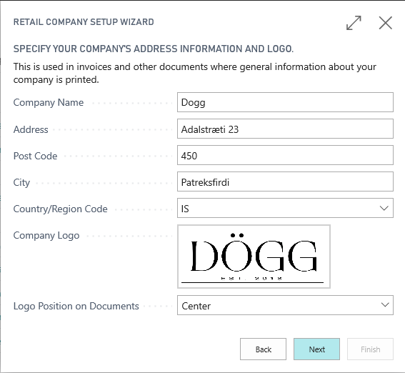
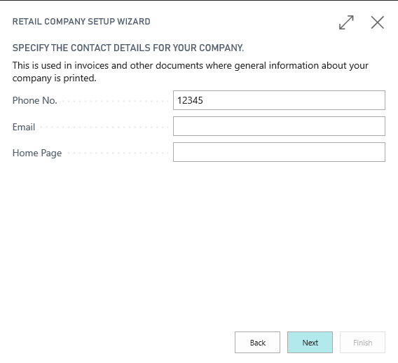
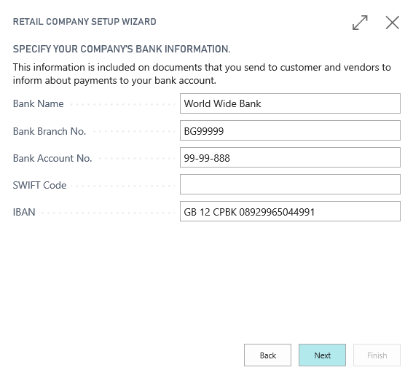
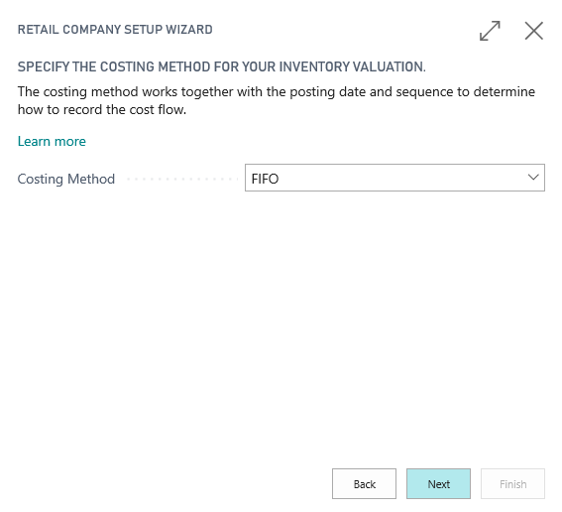
Business
overview
Best Practices
Implementation plan
Installation and configuration
Data setup and configuration
Processes

Slide 28
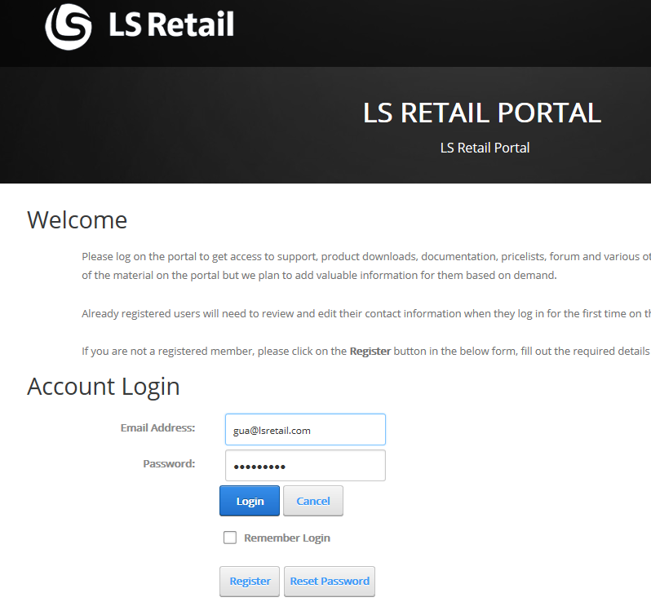
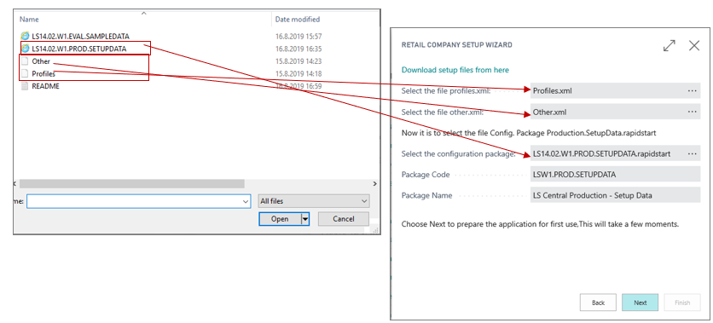
Business
overview
Best Practices
Implementation plan
Installation and configuration
Data setup and configuration
Processes

Slide 29
Business
overview
Best Practices
Implementation plan
Installation and configuration
Data setup and configuration
Processes
Retail Users
Note:
POS Super User allows the user to modify the the POS Setup.
At least one user needs to be a POS Super User.

Slide 30
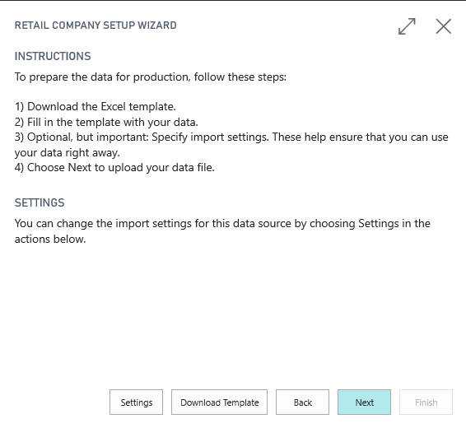
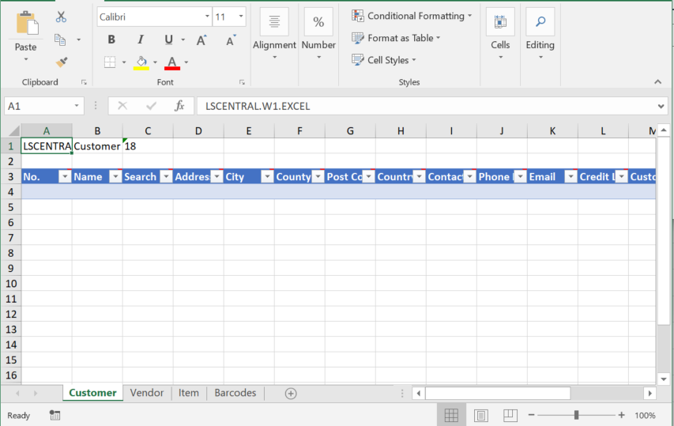
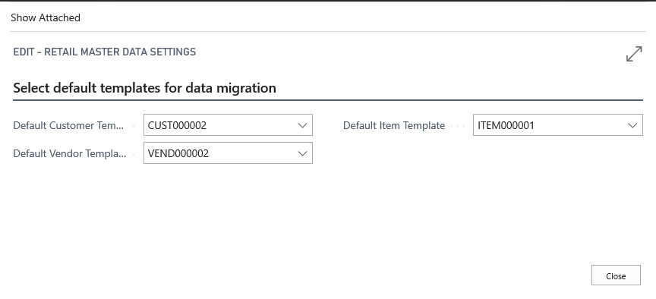
Business
overview
Best Practices
Implementation plan
Installation and configuration
Data setup and configuration
Processes
Migrate Business Data
To migrate business data, Customers, Vendors, Items and Barcodes. You need to download template and fill the templates with your data and you can specify import settings for Customers, Vendors and Items.

Slide 31
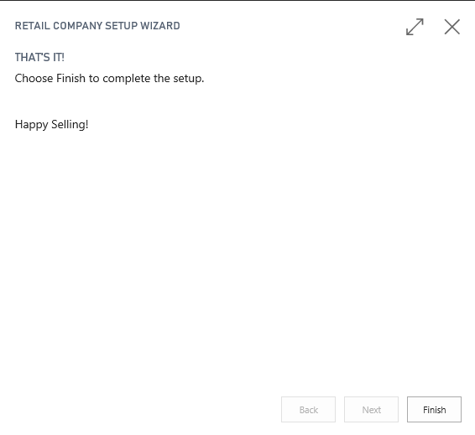
Business
overview
Best Practices
Implementation plan
Installation and configuration
Data setup and configuration
Processes
Finish

Slide 32
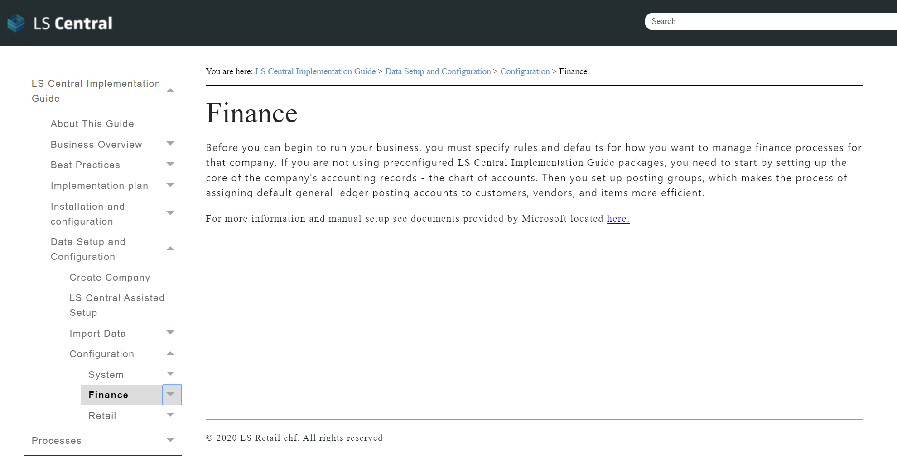
Business overview
Business
overview
Best Practices
Implementation plan
Installation and configuration
Data setup and configuration
Processes
Configuration - Finance
Note: There are other tables in the data application process that are reliant on the accounts included in LS Core packages.

Slide 33
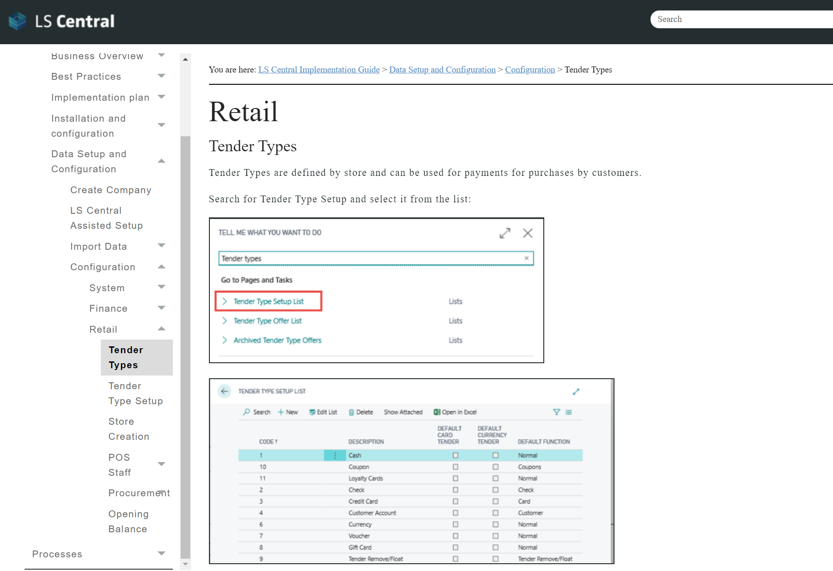
Business
overview
Best Practices
Implementation plan
Installation and configuration
Data setup and configuration
Processes
Configuration - Retail
Note: There are other tables in the data application process that are reliant on the accounts included in LS Core packages.

Slide 34
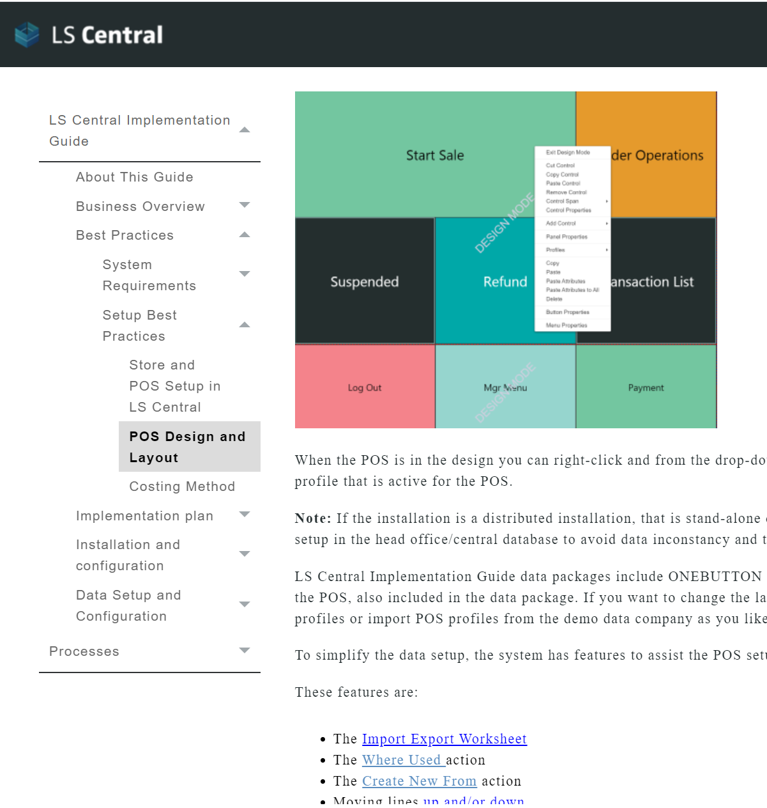
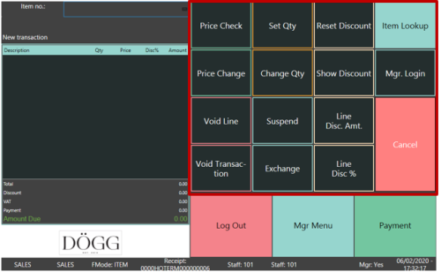
#OneButton

Slide 35
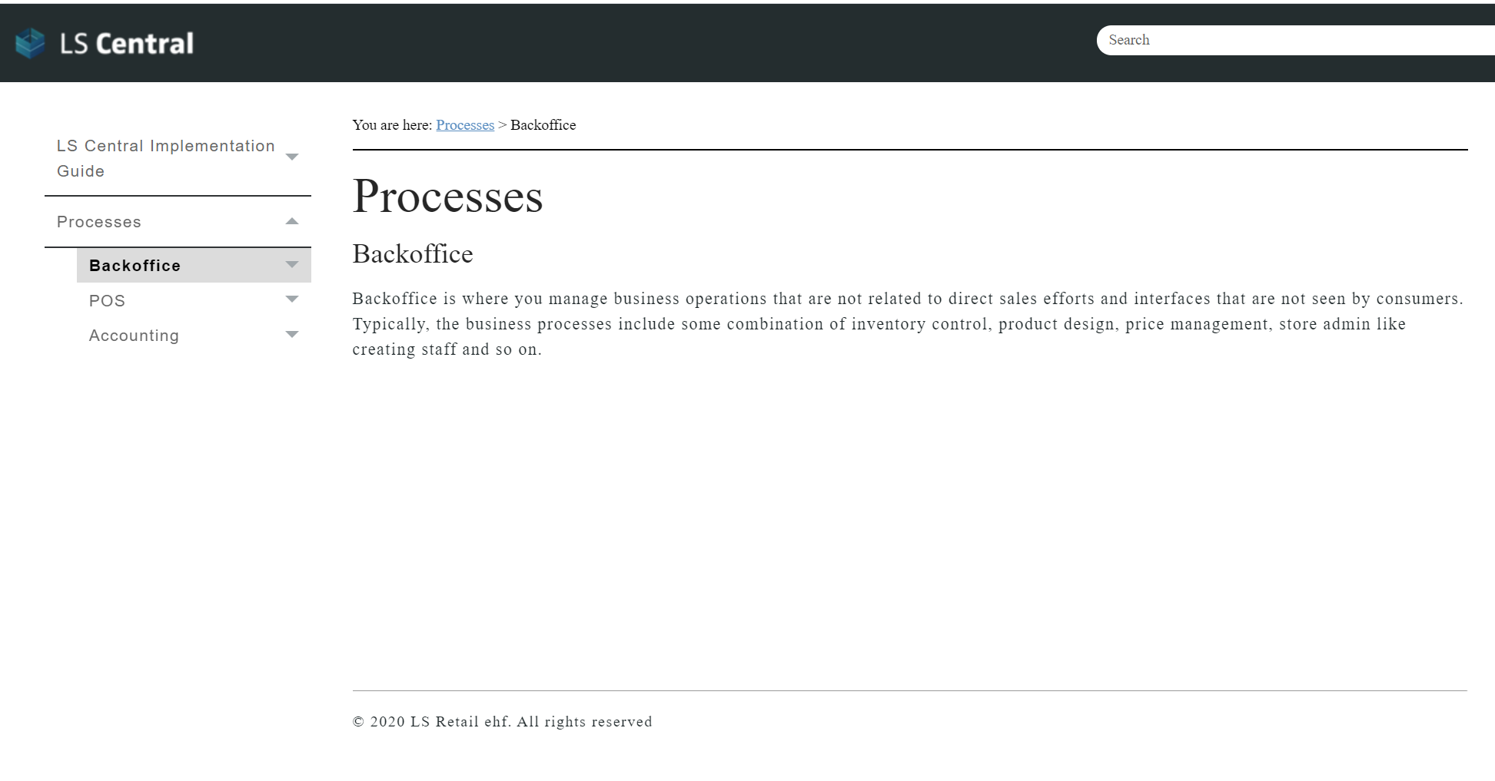
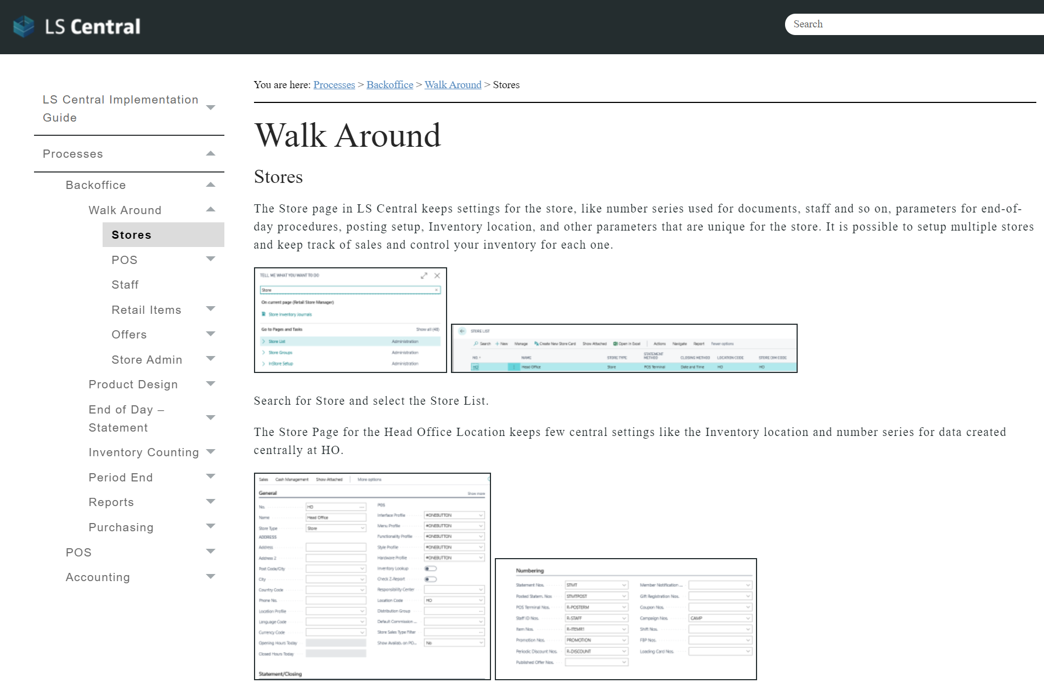
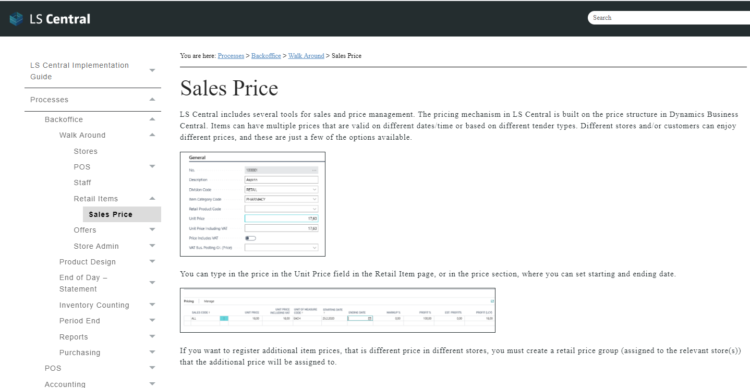
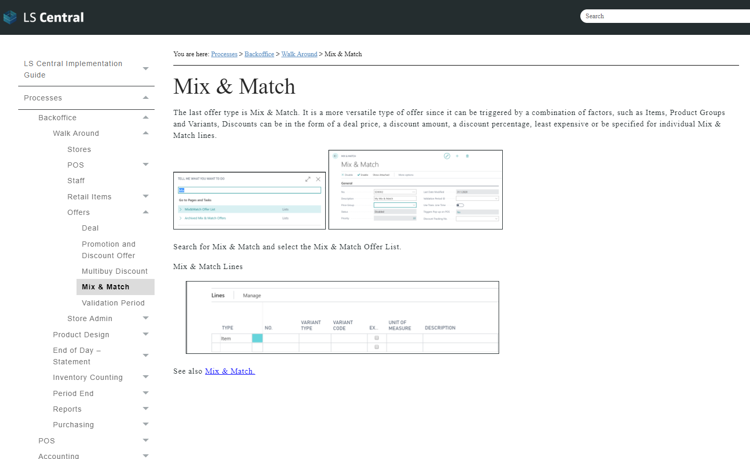
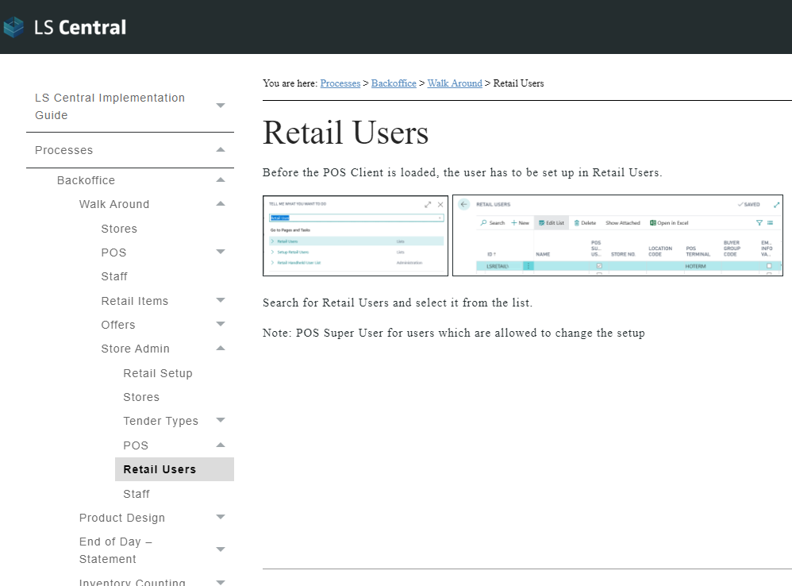
Business
overview
Best Practices
Implementation plan
Installation and configuration
Data setup and configuration
Processes

Slide 36
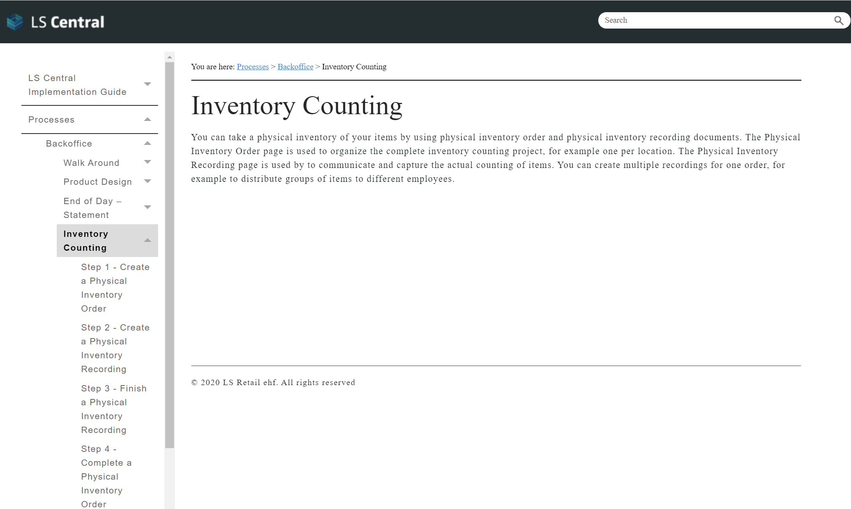
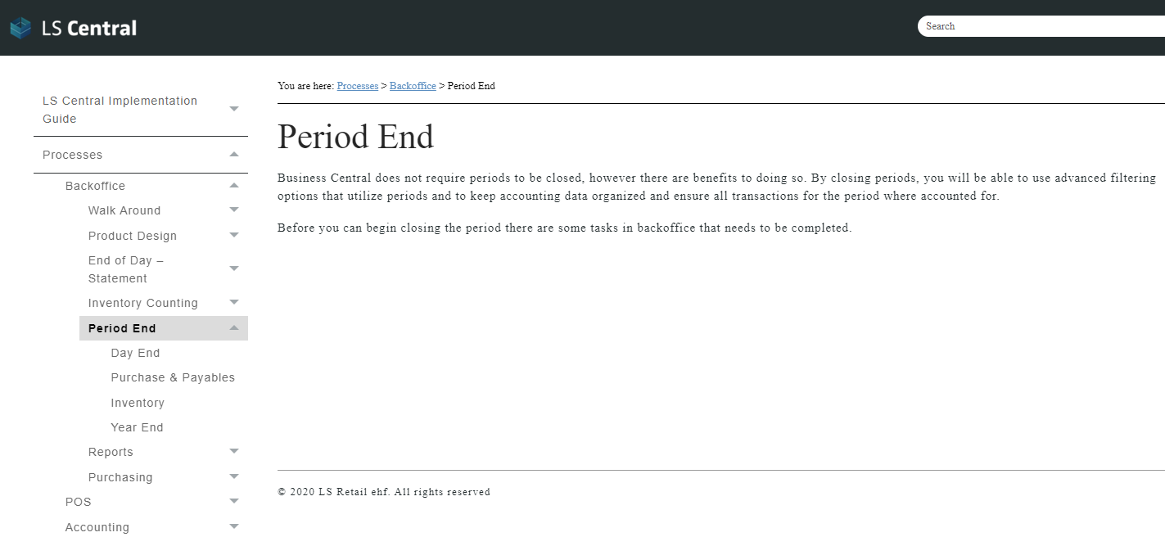
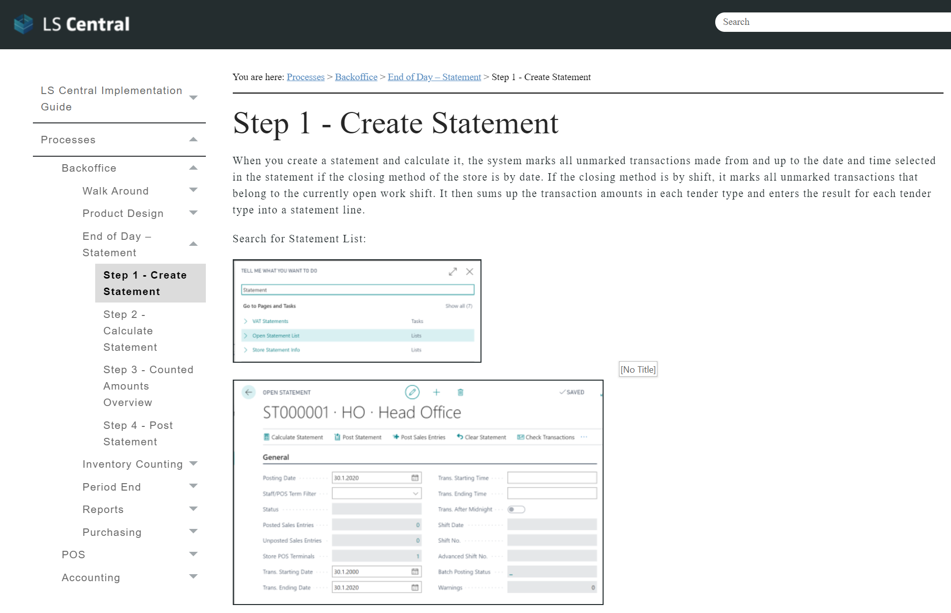
Business
overview
Best Practices
Implementation plan
Installation and configuration
Data setup and configuration
Processes

Slide 37
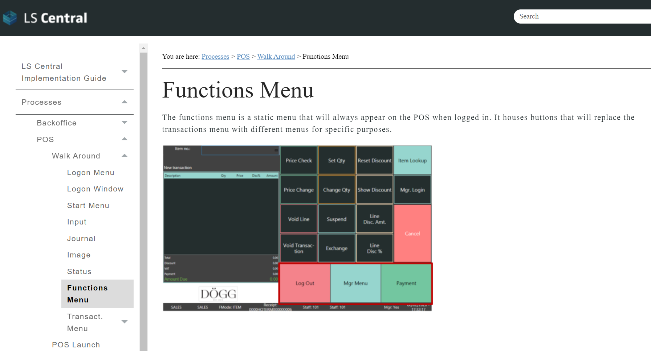
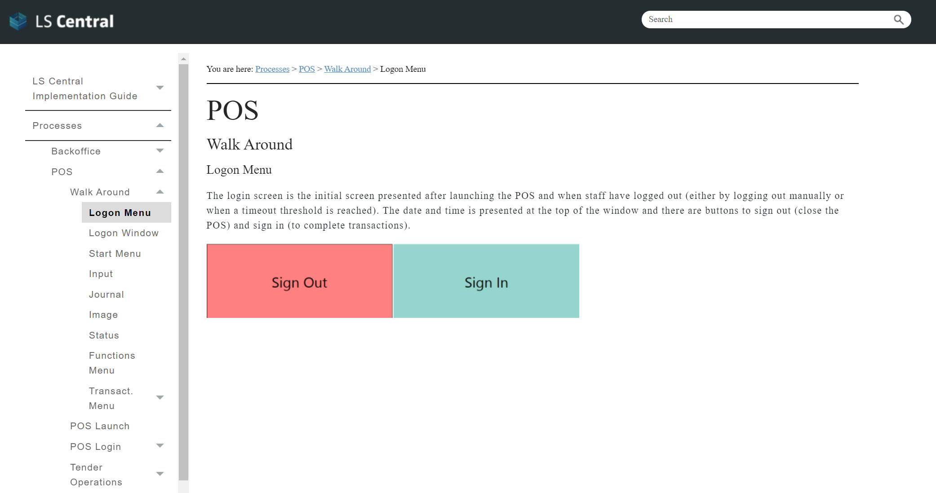
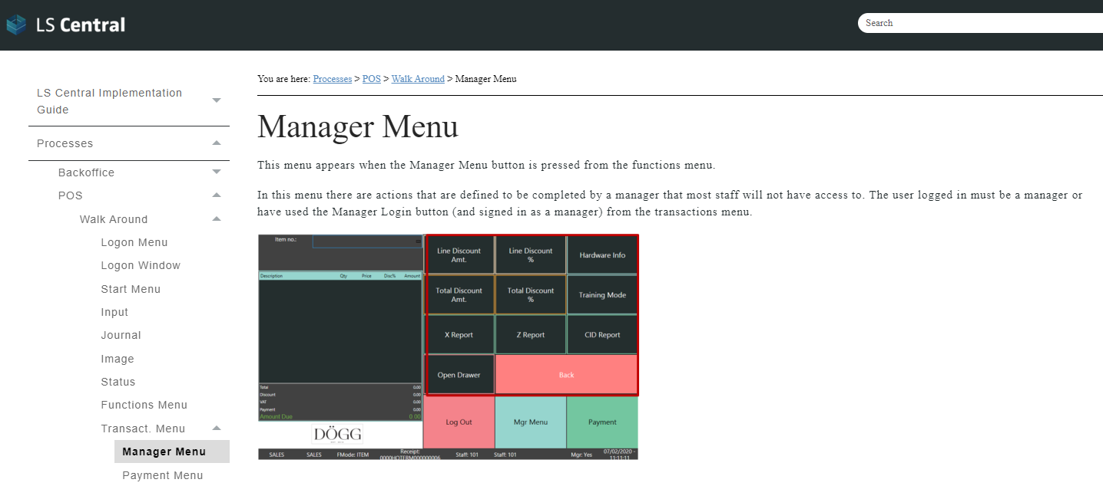
Business
overview
Best Practices
Implementation plan
Installation and configuration
Data setup and configuration
Processes

Slide 38
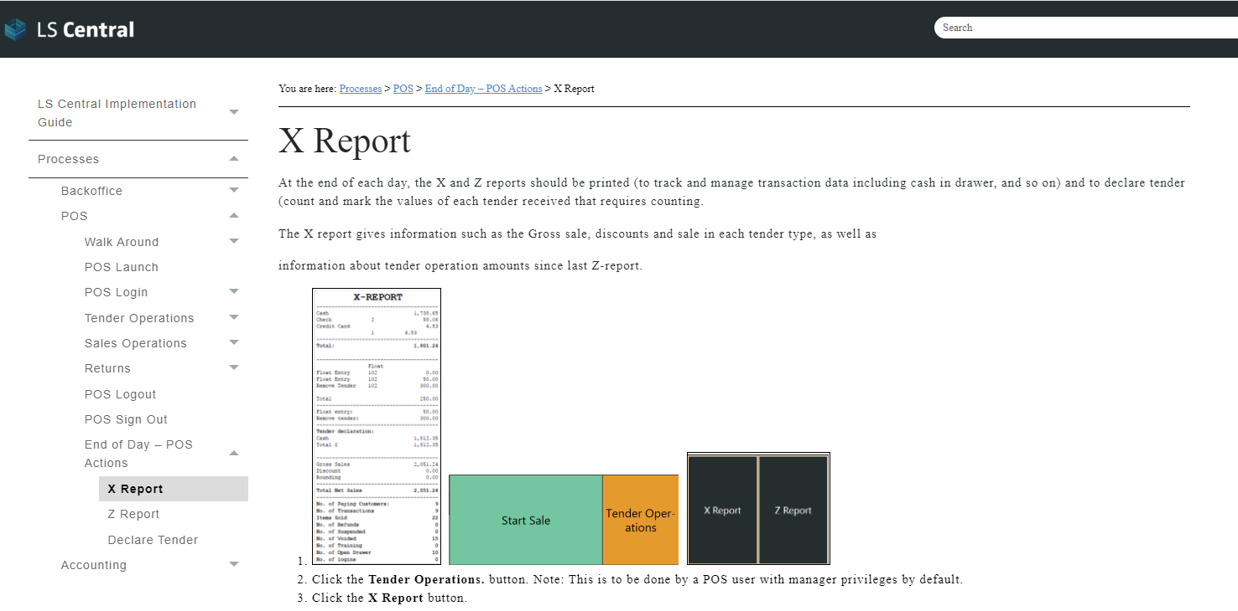
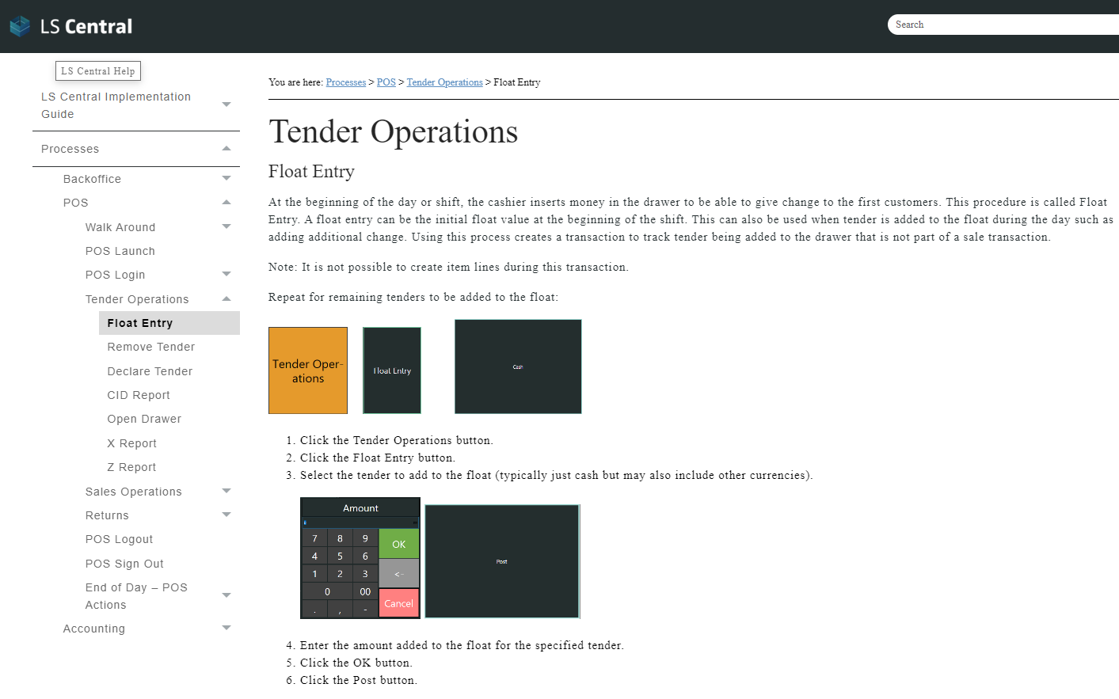
Business
overview
Best Practices
Implementation plan
Installation and configuration
Data setup and configuration
Processes

Slide 39
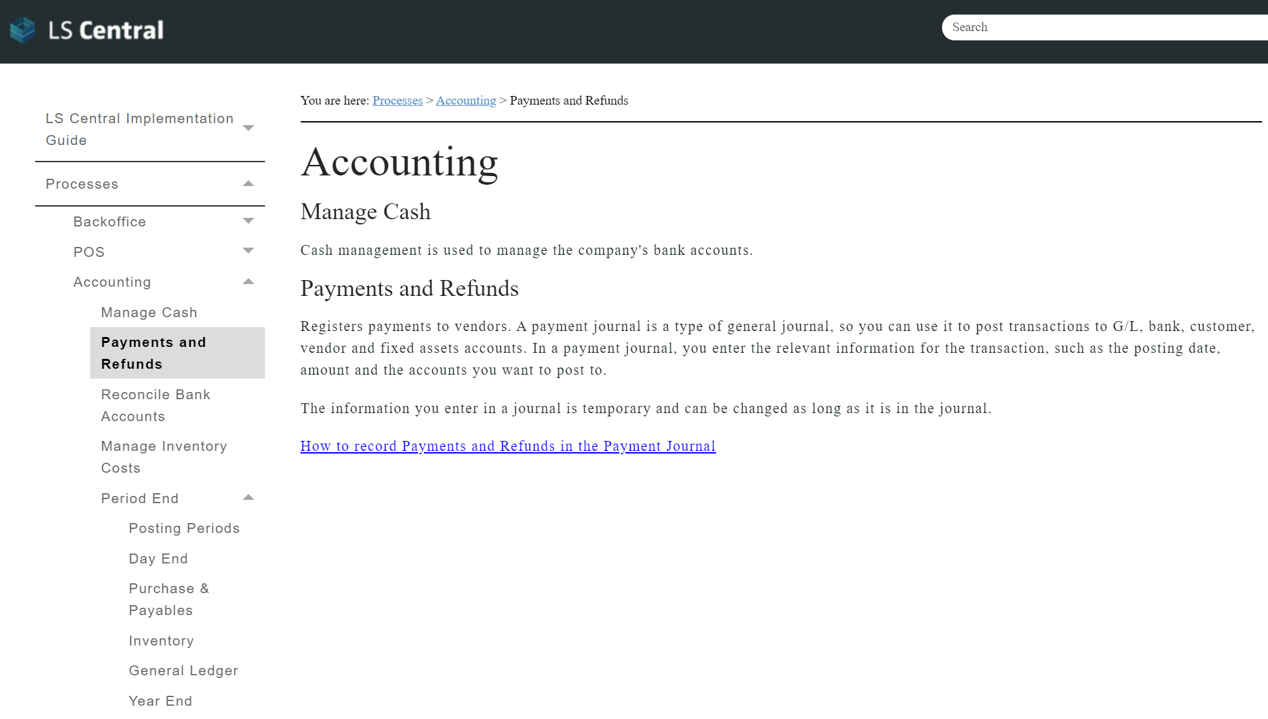
Business
overview
Best Practices
Implementation plan
Installation and configuration
Data setup and configuration
Processes

Slide 40
LS Core?
Go Current?
Go live, stay current

Slide 41
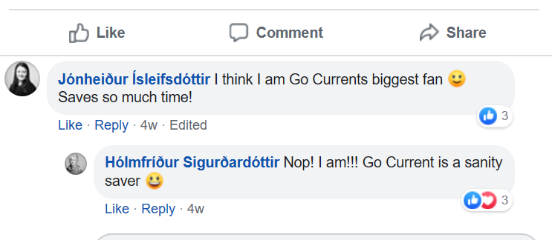
Go Current fan club in LS Retail
For one it saves us time, a lot of time!
Regarding getting latest versions - it's so easy I have nothing to add to it, you just use the Go Current app to do the work for you.
Self Service Portal: The best part is that once you have something setup up you can easily update it to the latest versions without creating a new database so you still have all your test data available. Once I wrapped my head around how powerful this tool is I really enjoy using it :)

Slide 42
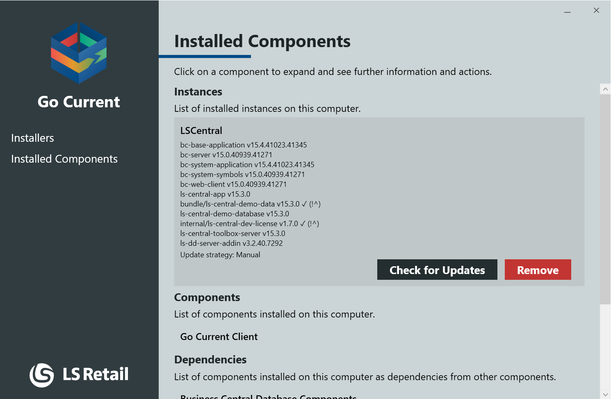
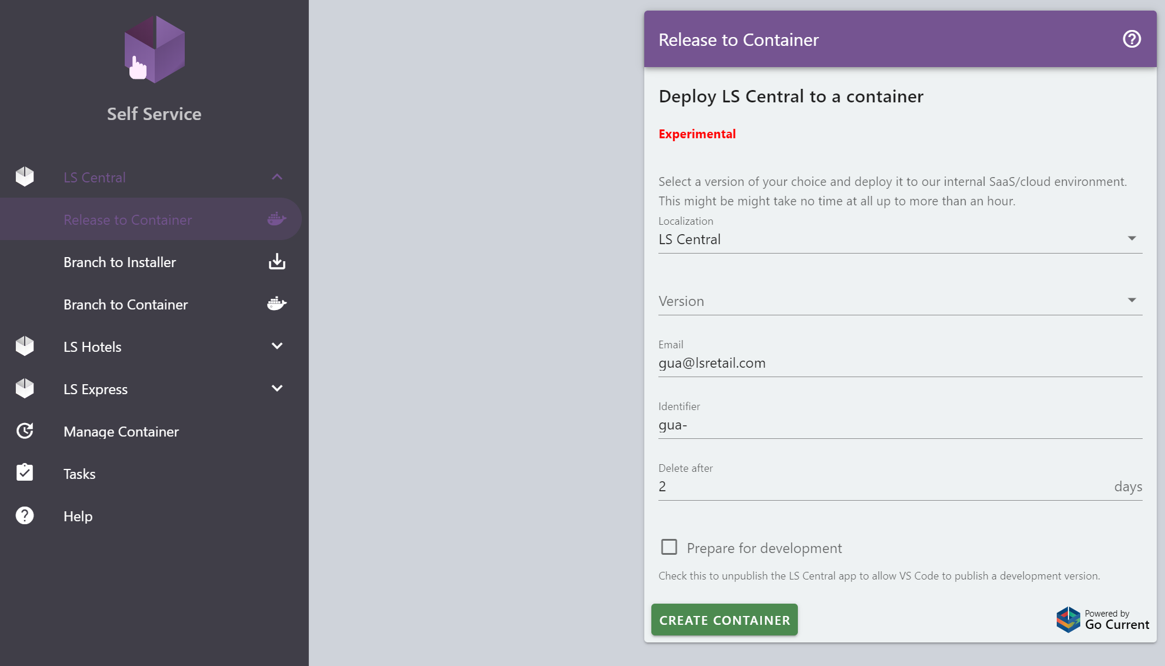
Get Latest release/update Self Service Portal

Slide 43
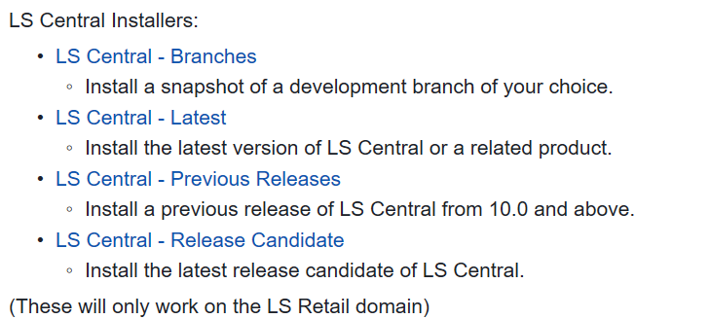
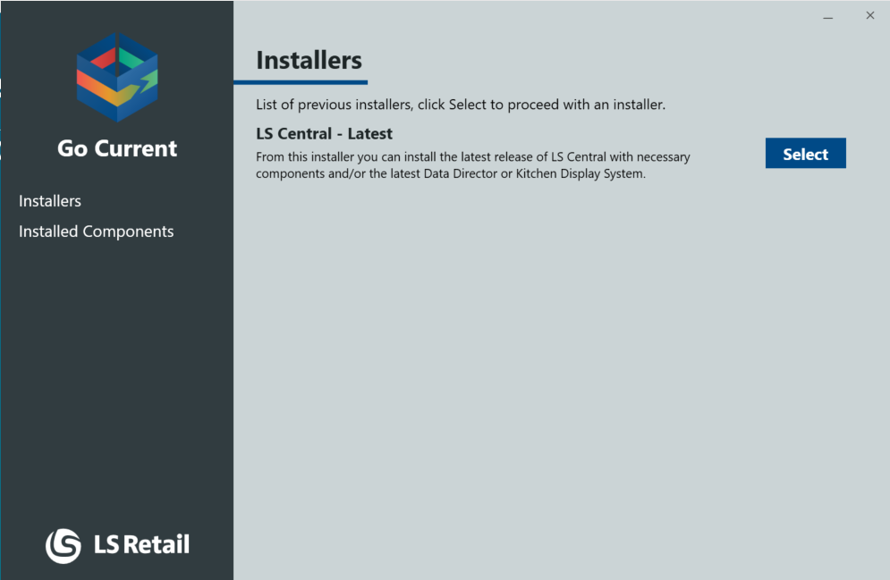
Get latest release

Slide 45
Check for Updates
The best part is that once you have something setup up you can easily update it to the latest versions without creating a new database so you still have all your test data available.

Slide 46
Self Service Portal

Slide 47
Self Service Portal

Slide 48
Self Service Portal

Slide 51
You can do it too
Go Current Server
V1.2
Go Current Server
V1.2
V1.2 + C1
Test partner addon

Slide 52
Need help to get started?
https://help.gocurrent.lsretail.com/
https://www.yammer.com/gocurrent/
Technical Webinar and Training

Slide 53
SURPRISE!

Slide 54
For you my friend
Get latest version will be available for all partners
We are looking into making the Self Service Portal available too.

Slide 55
Why are we doing this?
Speed up implementation time
Quickly onboard new partners and consultants
Improve quality and minimize risk in implementations
Increase sales

Slide 56
Questions?

Slide 57
LS Academy
Course: CF-300 LS Central for retail – General Base Course with Certification
When: 18th to 28th of May (excluding 22, 23, 24) from 07:00 am to 11:00 am GMT
Price: 1,310€ / participant – Special 10% discount for webinar attendees by email academy@lsretail.com

Slide 59
Desktop/POS

Slide 60
POS/Tablet

Slide 61
Tablet/surfacePro

Slide 62
Tablet/iPad

Slide 63
Mobile

Slide 65
The width of the logo “box” and the logo ‘S’ mark the minimum space required around the logo

Slide 66
The width of the logo “box” marks the minimum space required around the logo

Slide 67
The width of the logo “box” and the logo ‘S’ mark the minimum space required around the logo

Slide 68
The width of the logo “box” marks the minimum space required around the logo

Slide 69
The logo ‘R’ marks the minimum space required around the logo

